Slide 1
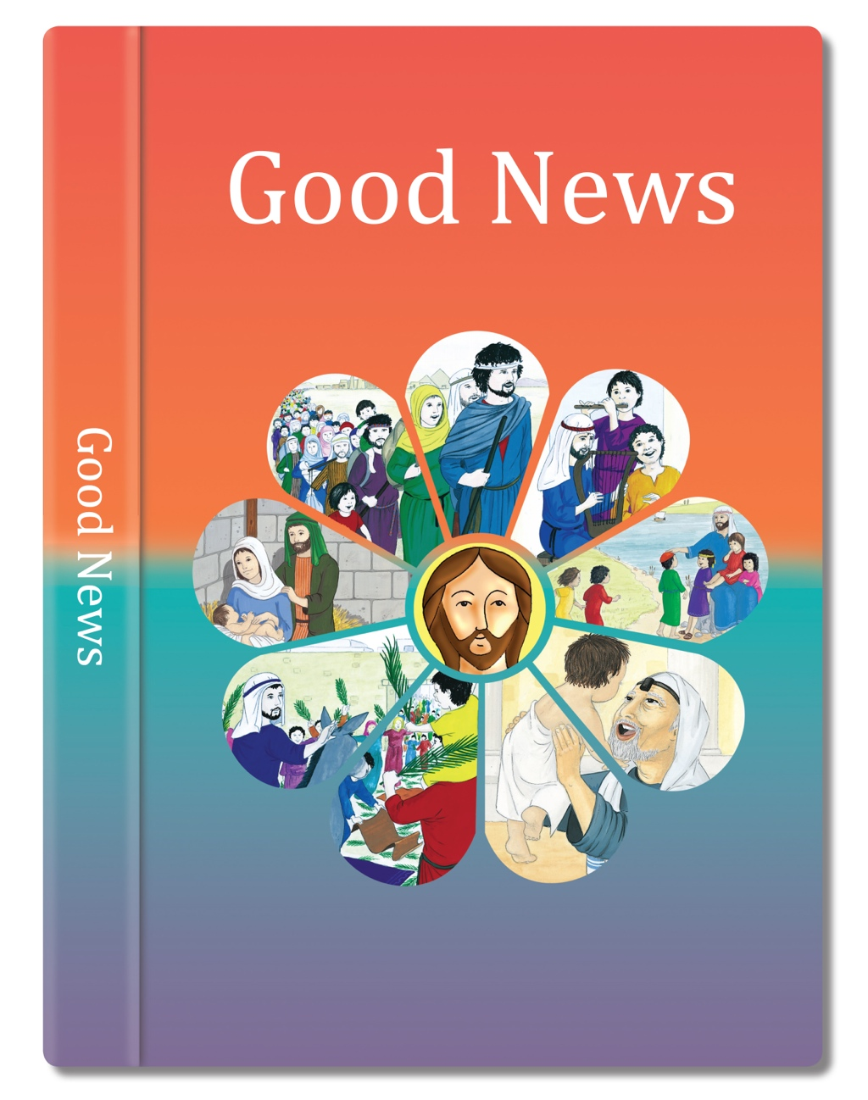

Slide 2

As I was travelling and coming near Damascus, about midday a bright light from the sky flashed suddenly round me. I fell to the ground and heard a voice saying to me, “Saul, Saul! Why do you persecute me?”
In that city was a man named Ananias, a religious man who obeyed our Law and was highly respected by all the Jews living there. He came to me, stood by me, and said, “Brother Saul, see again!” At that very moment I saw again and looked at him. He said, “The God of our ancestors has chosen you to know his will, to see his righteous Servant, and to hear him speaking with his own voice.
“Who are you, Lord?” I asked. “I am Jesus of Nazareth, whom you persecute,” he said to me. The men with me saw the light but did not hear the voice of the one who was speaking to me. I asked, “What shall I do, Lord?” and the Lord said to me, “Get up and go into Damascus, and there you will be told everything that God has determined for you to do” I was blind because of the bright light, and so my companions took me by the hand and led me into Damascus.
For you will be a witness for him to tell everyone what you have seen and heard. And now, why wait any longer? Get up and be baptised and have your sins washed away by praying to him.”
Based on Acts 22: 6-16

Slide 3


