Slide 1
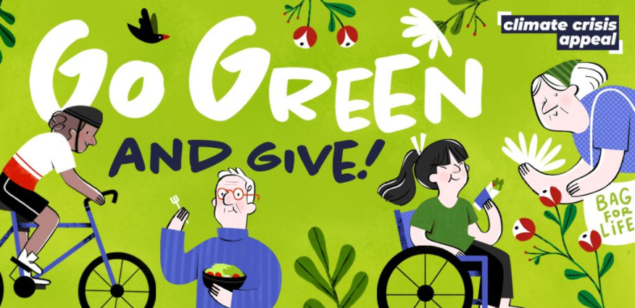
CAFOD

Slide 2
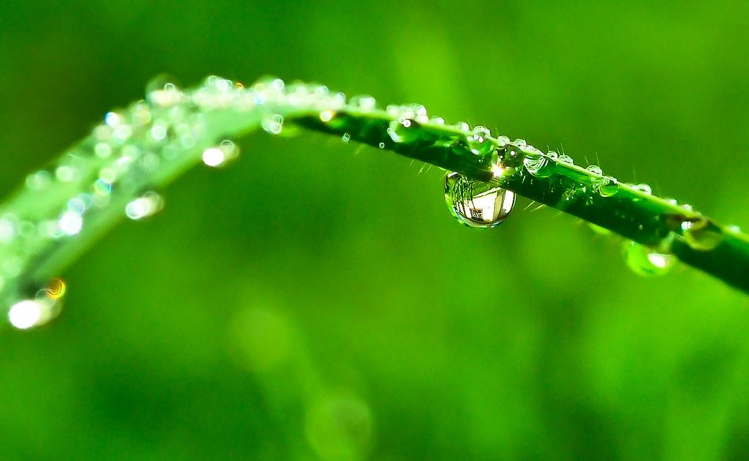
Go Green
Go Green is very special day when schools all over England and Wales wear green to school. Go Green promotes Reuse Reduce Recycle.
It can help people like Luana. Each year, nearby farmers burn their fields and it stops the forest growing back. Sometimes the fire can lead to different areas being destroyed. This means that all the crops have burned and all of the trees that grow the fruit and nuts which Luana sells have been destroyed.

Slide 3


We can go green by…
Walking to school
Turning the tap of while brushing your teeth
Switching the lights off
Reuse,Reduce and Recycle
And lots of others way

Slide 4

TO HELP SAVE OUR PLANET
REUSE
REDUCE
RECYCLE

