Slide 1
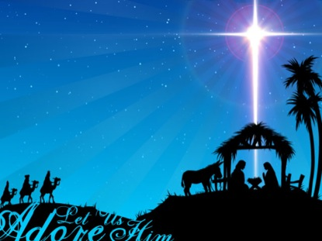
Barmy Bethlehem
Reception Christmas Play
2022

Slide 2
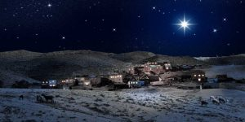
Our story begins long ago in a place called Bethlehem where Jesus was born.
…

Slide 3
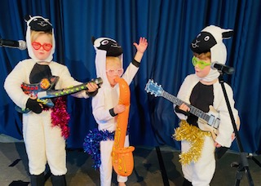
In Bethlehem there were also 3 Party Sheep! They loved to party and they like nothing better than getting up to all sorts of mischief.

Slide 4
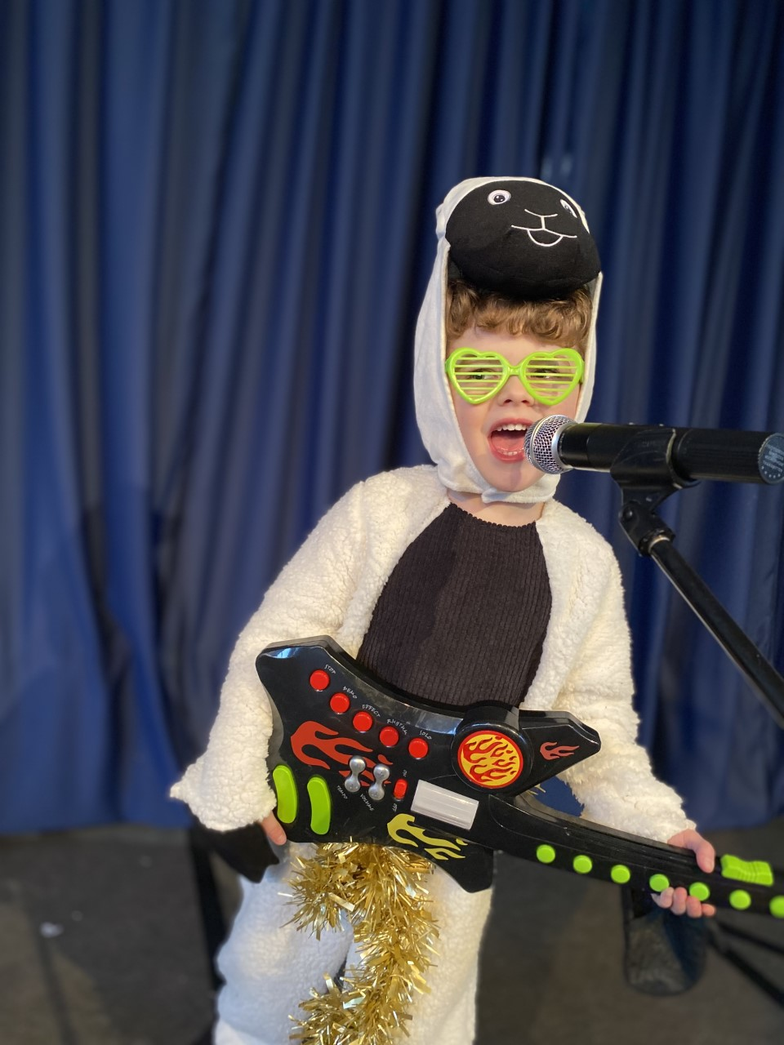
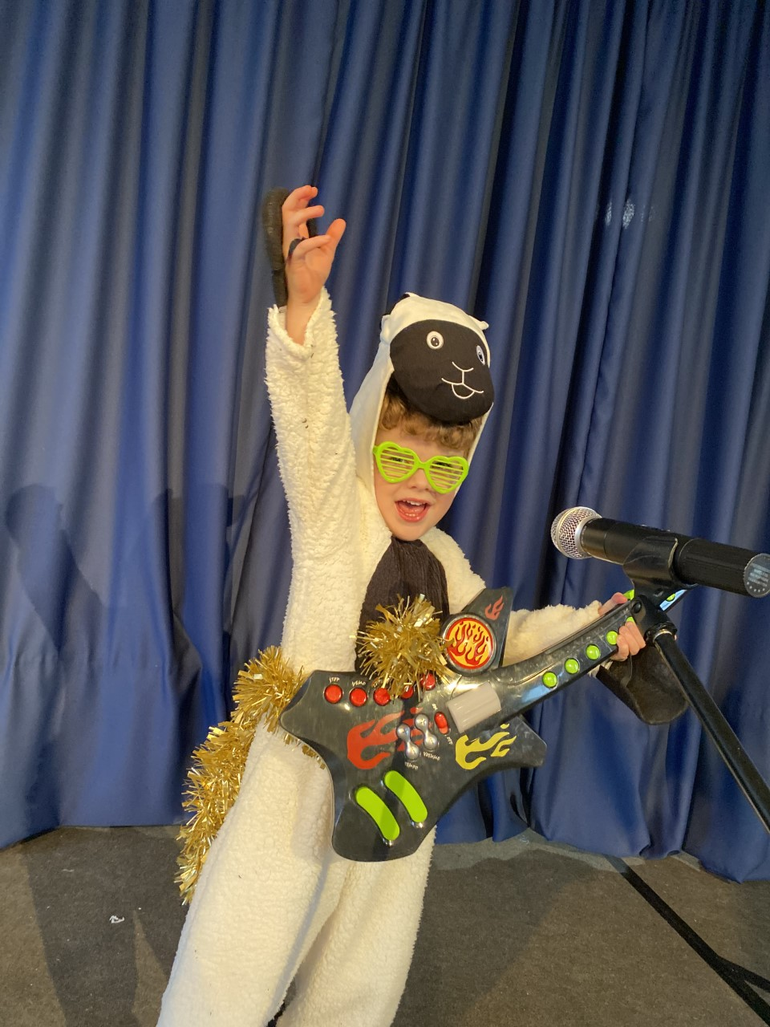
This is Cheeky!

Slide 5
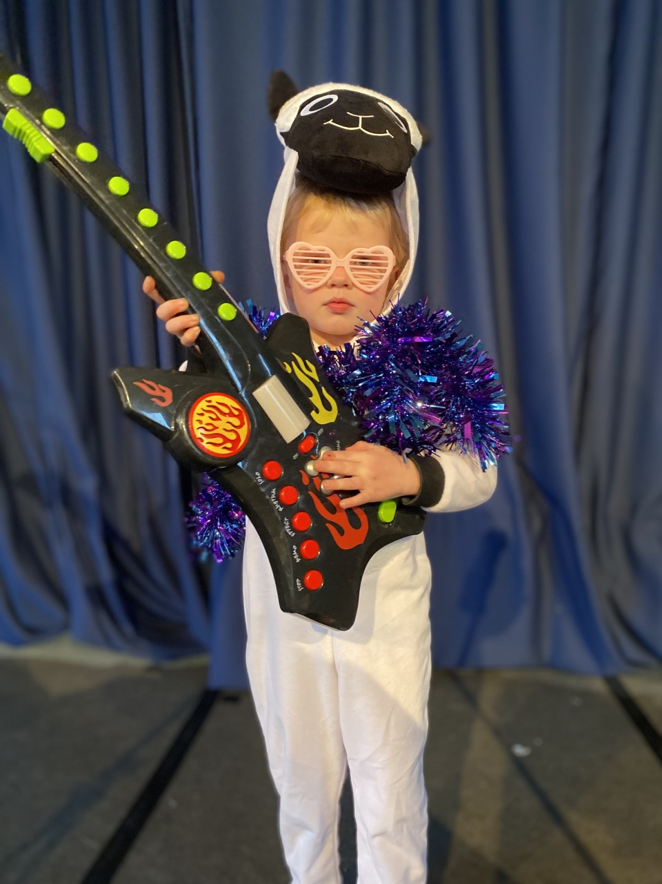
This is Rascal !

Slide 6
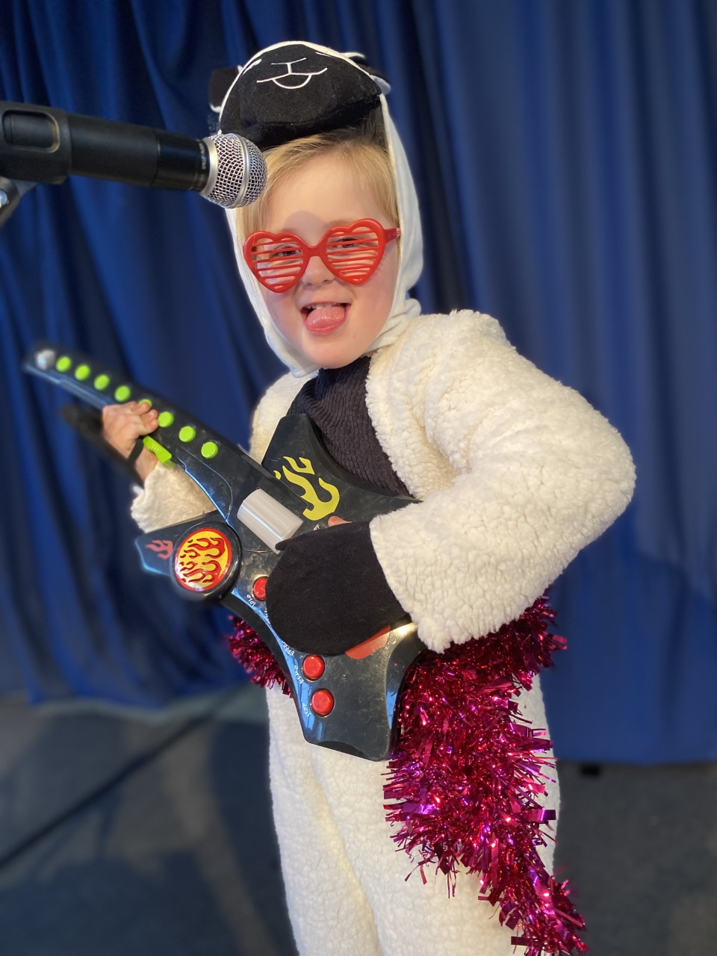
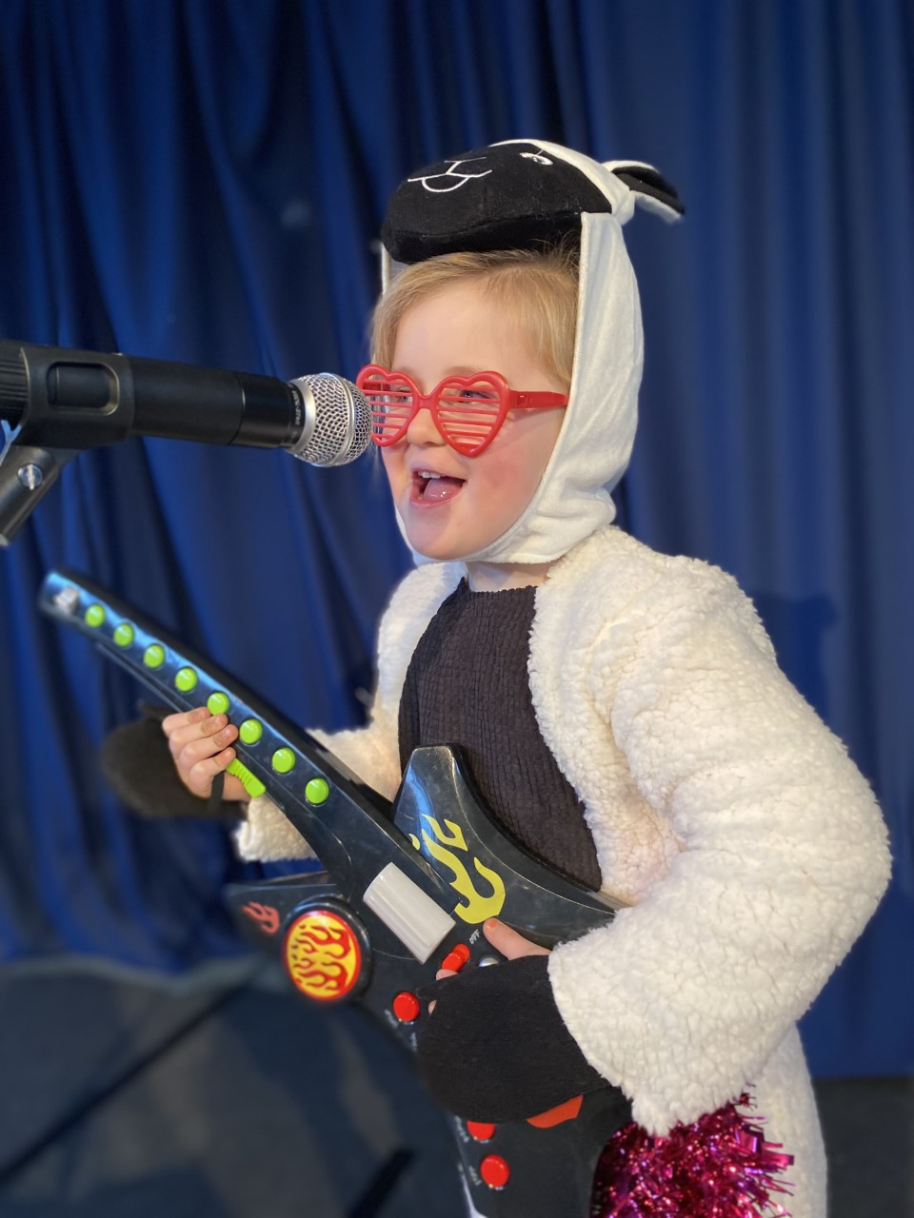
This is Scamp!

Slide 7
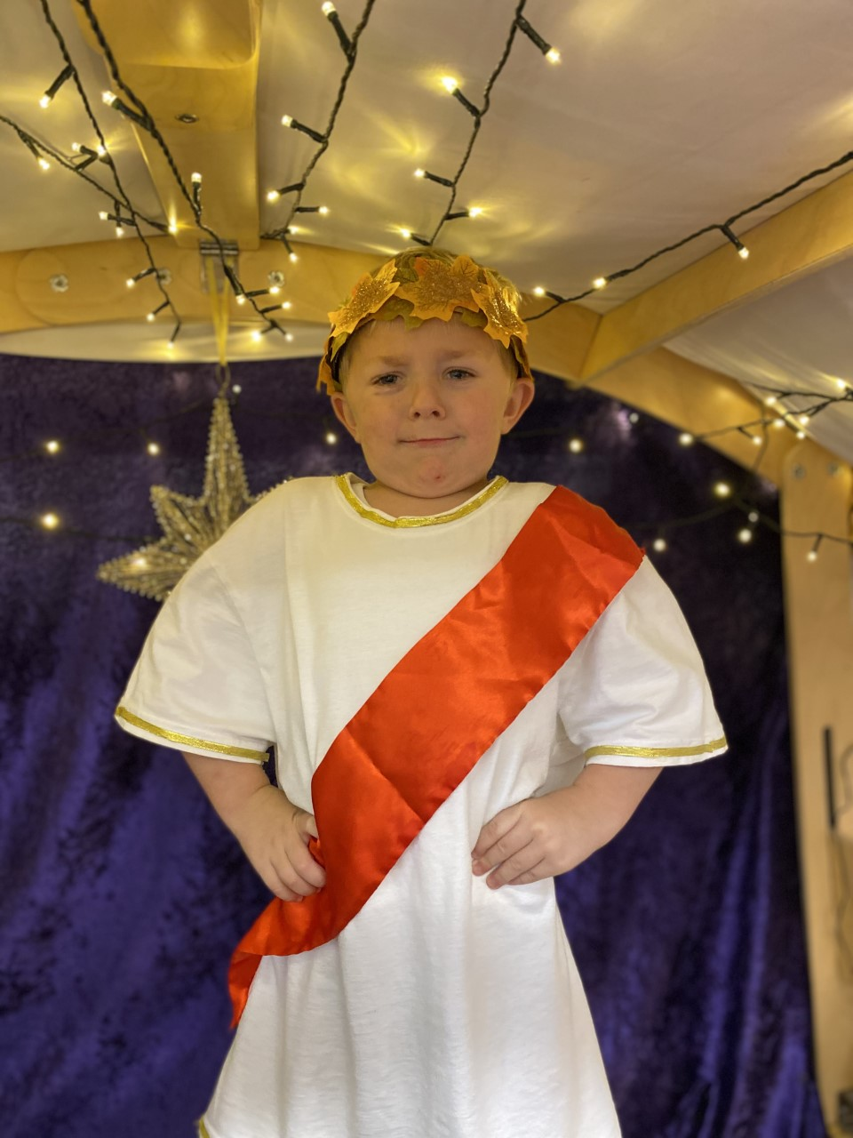
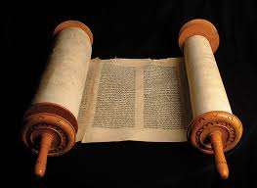
Caesar has ordered a census.
Bethlehem became a busy place.

Slide 8
This is Mary and Joseph. God had chosen them for a very special job. They had travelled for many miles and were exhausted.
…

Slide 9
Little Donkey
Little donkey, little donkey
On the dusty road
Got to keep on plodding onwards
With your precious load.
Been a long time, little donkey
Through the winter's night
Don't give up now, little donkey
Bethlehem's in sight.

Slide 10
Little Donkey
Ring out those bells tonight
Bethlehem, Bethlehem
Follow that star tonight
Bethlehem, Bethlehem
Little donkey, little donkey, had a heavy day
Little donkey, carry Mary safely on her way

Slide 11
Little Donkey
Little donkey, little donkey, journey's end is near
There are wiseman waiting for a sign to bring them here
Do not falter little donkey, there's a star ahead
It will guide you, little donkey, to a cattle shed.

Slide 12
Little Donkey
Ring out those bells tonight
Bethlehem, Bethlehem
Follow that star tonight
Bethlehem, Bethlehem
Little donkey, little donkey, had a heavy day
Little donkey, carry Mary, safely on her way
Little donkey, carry Mary, safely on her way.

Slide 13
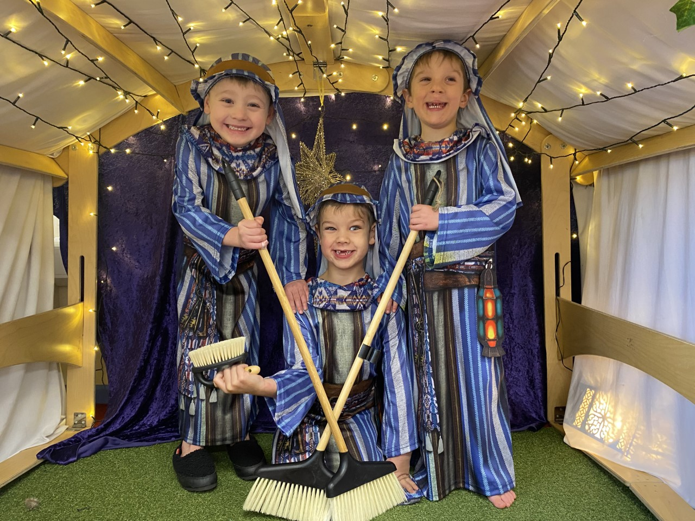
There were lots of inns in Bethlehem, the innkeepers were very busy , but there was one very big problem. NO ROOM !

Slide 14
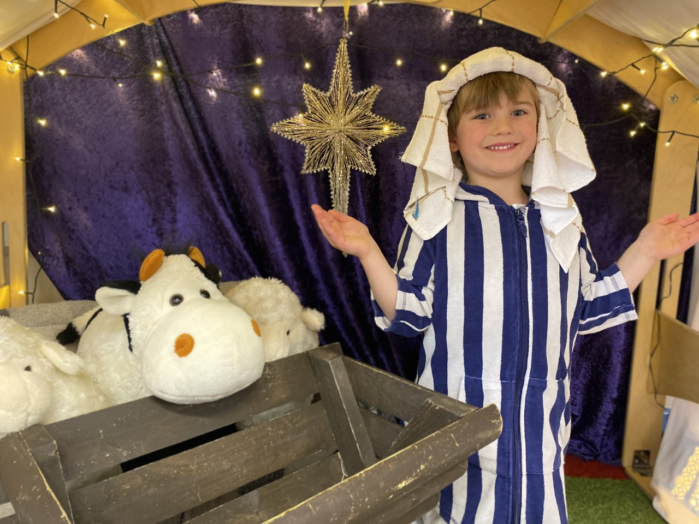
However, one innkeeper took pity on Mary and Joseph.
“All I can offer you is a stable,

Slide 15
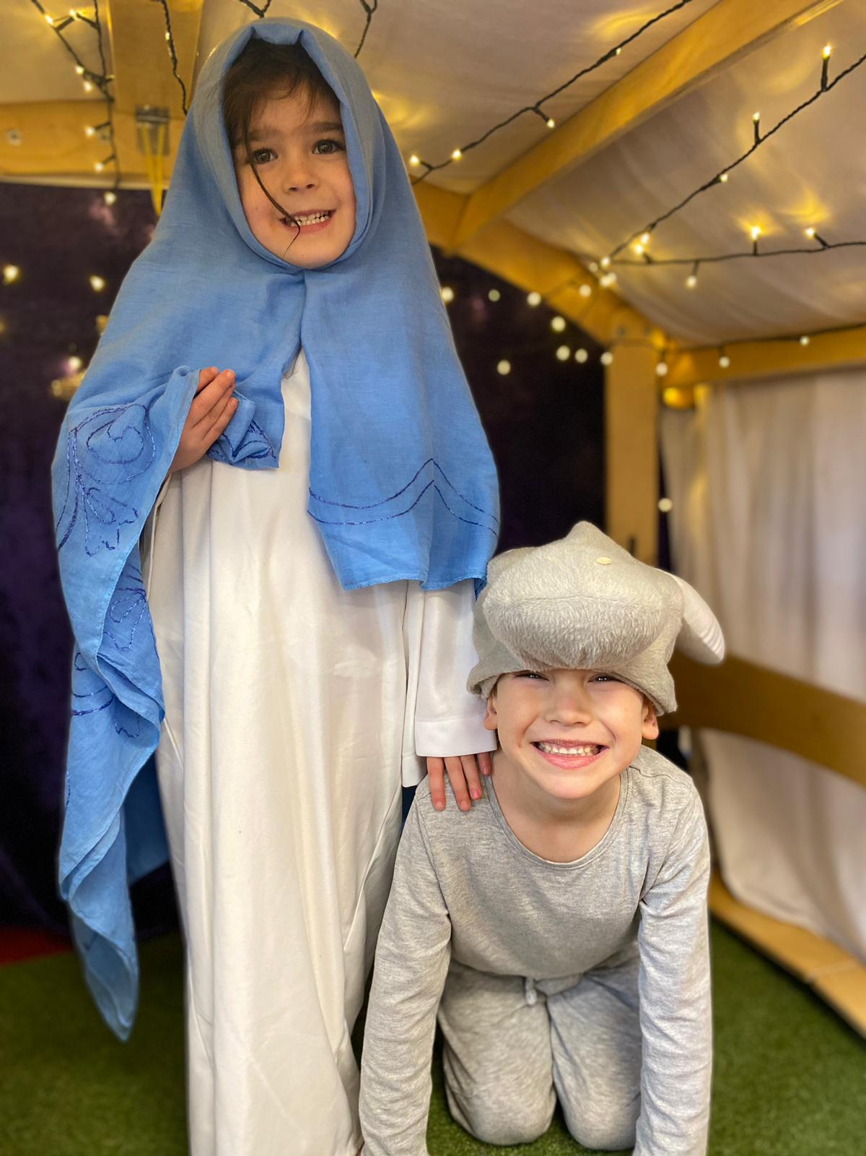
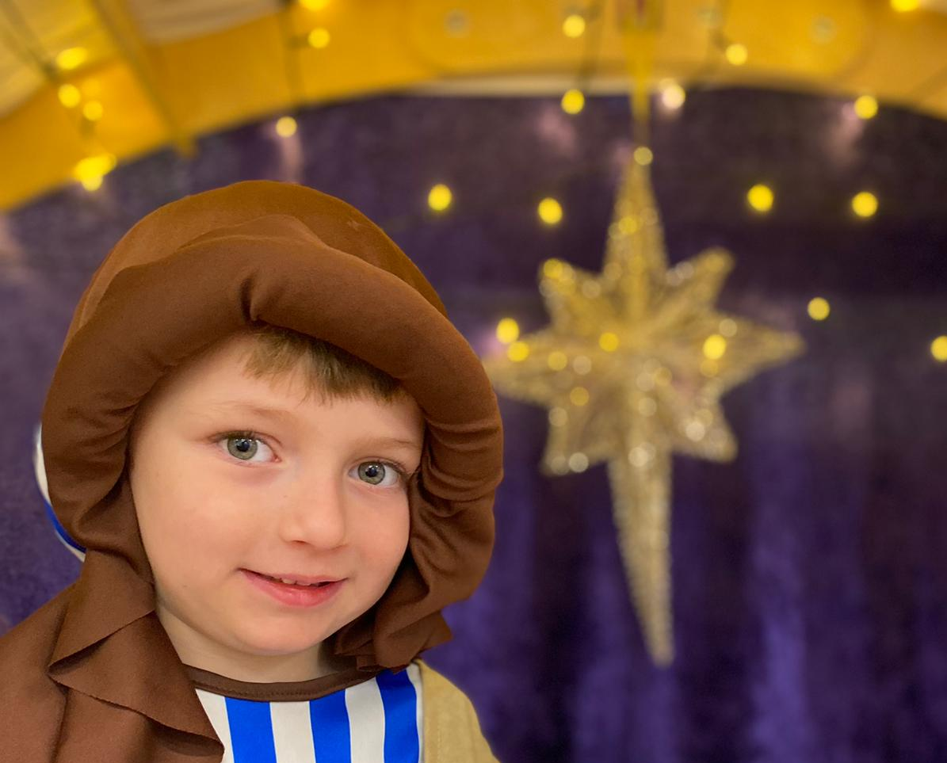
Mary and Joseph were grateful. At least they had somewhere to rest now and so did their donkey!

Slide 16
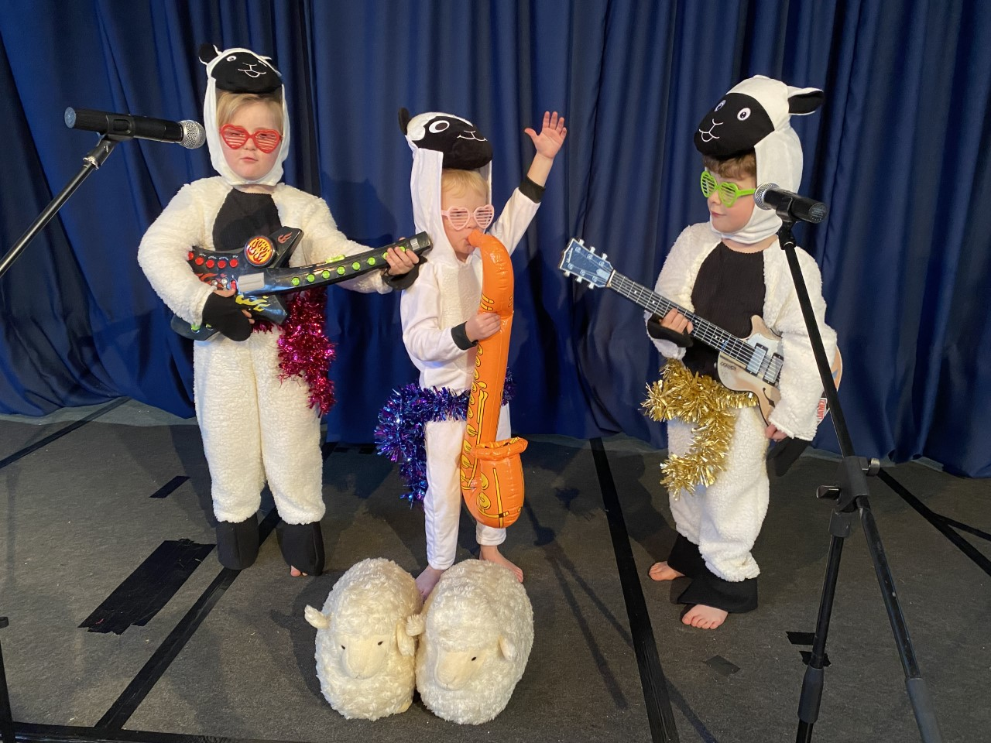
In the hills above Bethlehem, things were a little quieter, but not by much!
.

Slide 17
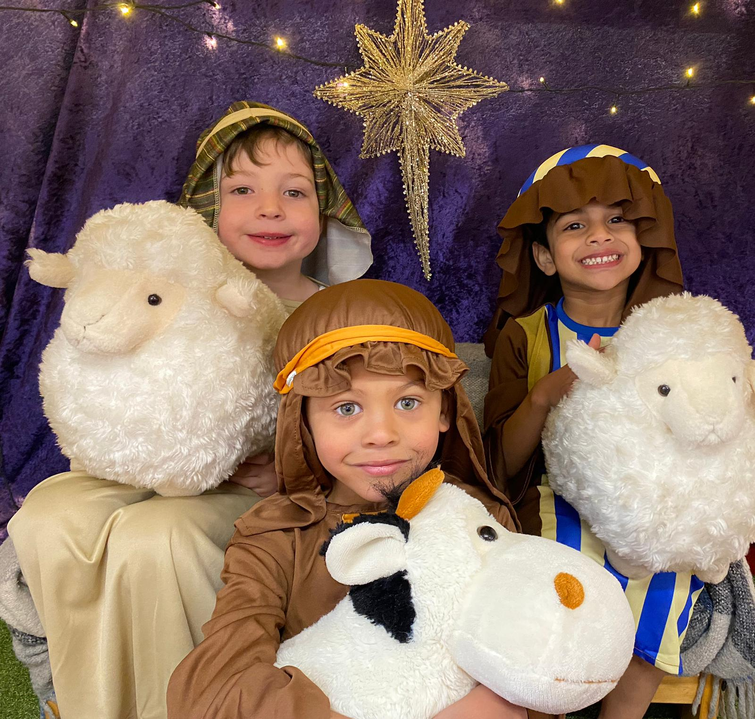
Everything was quiet now in Bethlehem. The shepherds were watching their sheep on the hills.

Slide 18
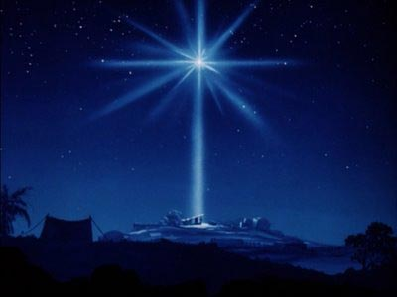
Suddenly, there was an explosion of bright, light in the sky above them!

Slide 19
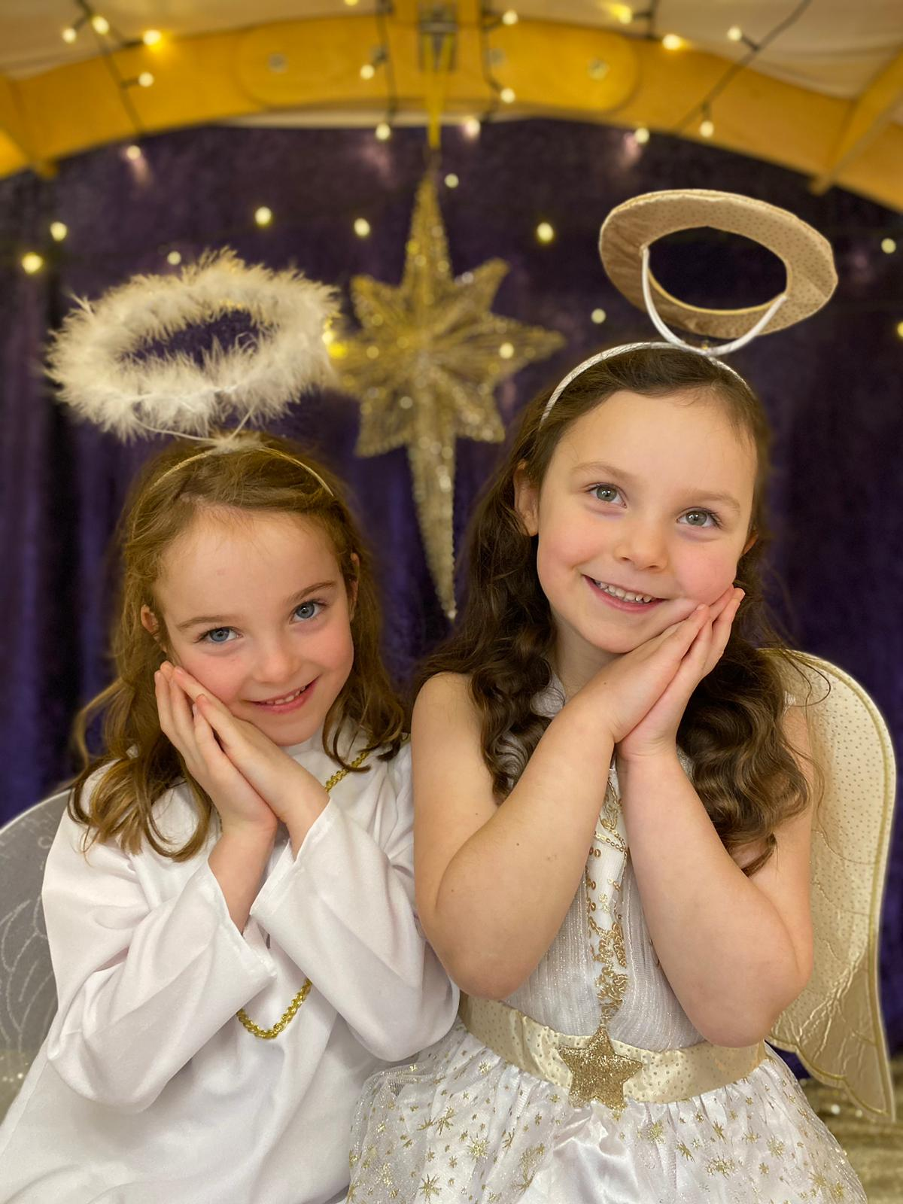
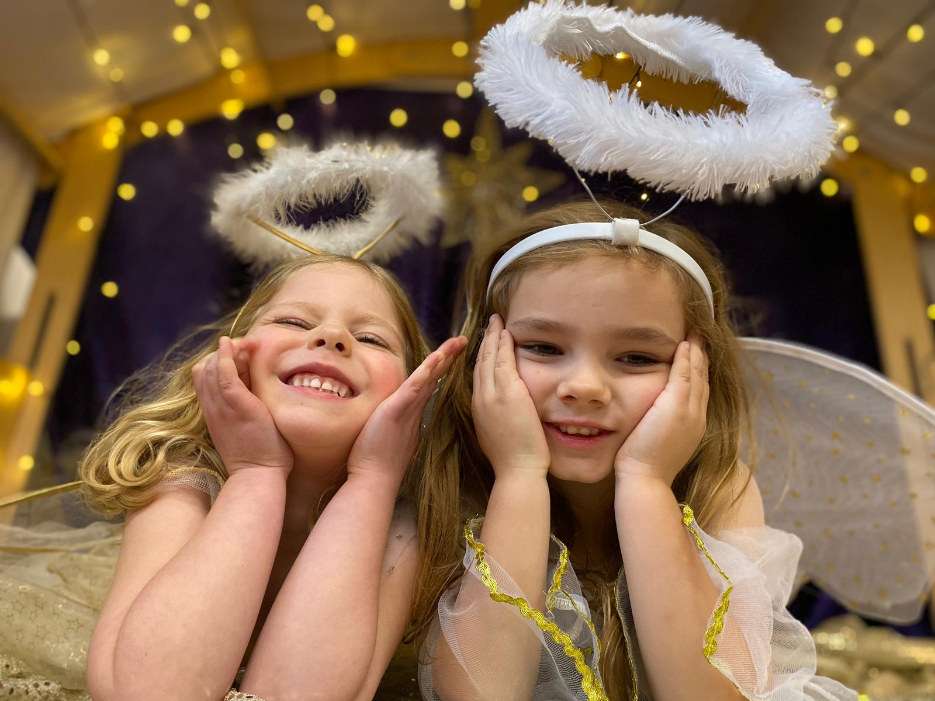
The Shepherds and the Angels
‘These are angels. They had some news for the shepherds. Don’t be afraid
Luke 2:9

Slide 20
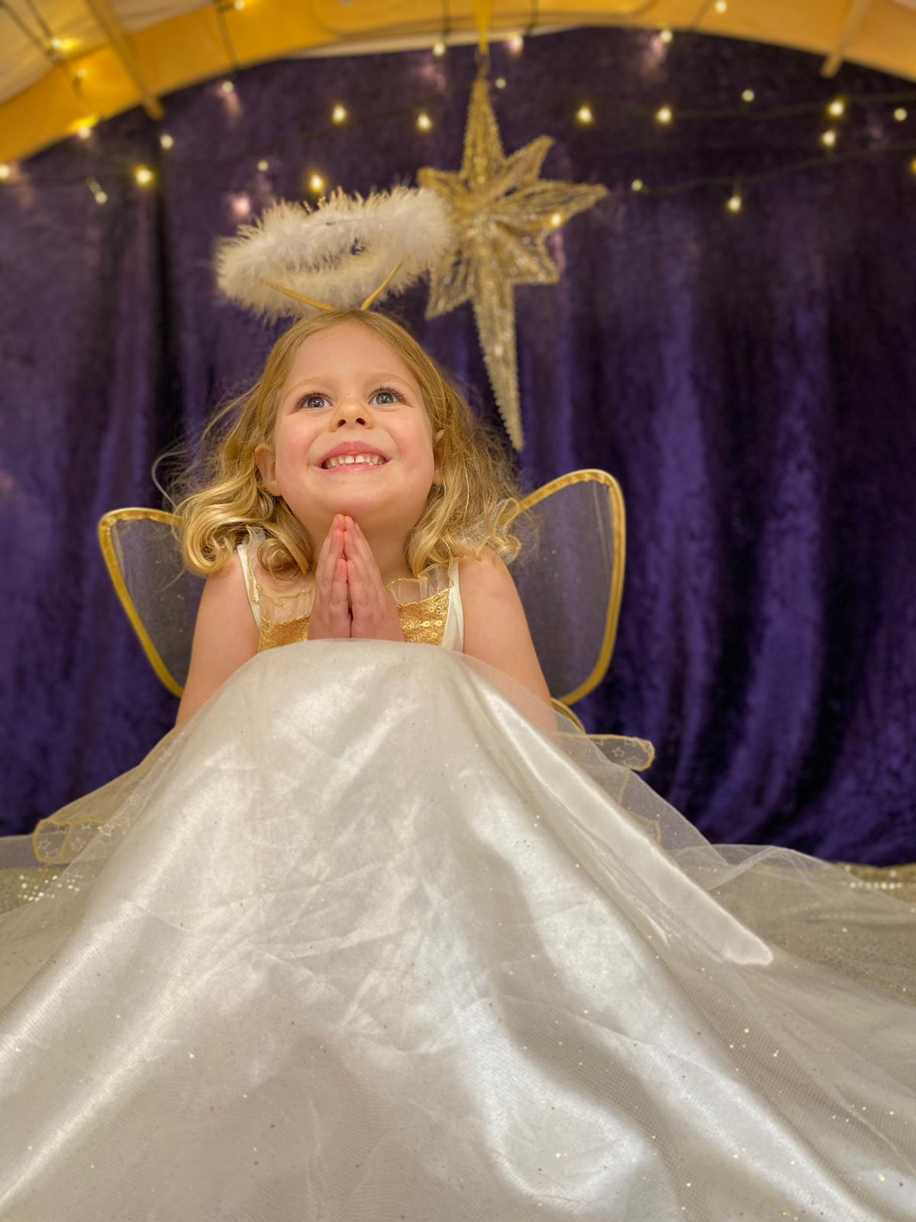
The Angel Gabriel was God’s messenger and brought them tidings of great joy.
Today a baby is born for you and for everyone.

Slide 21
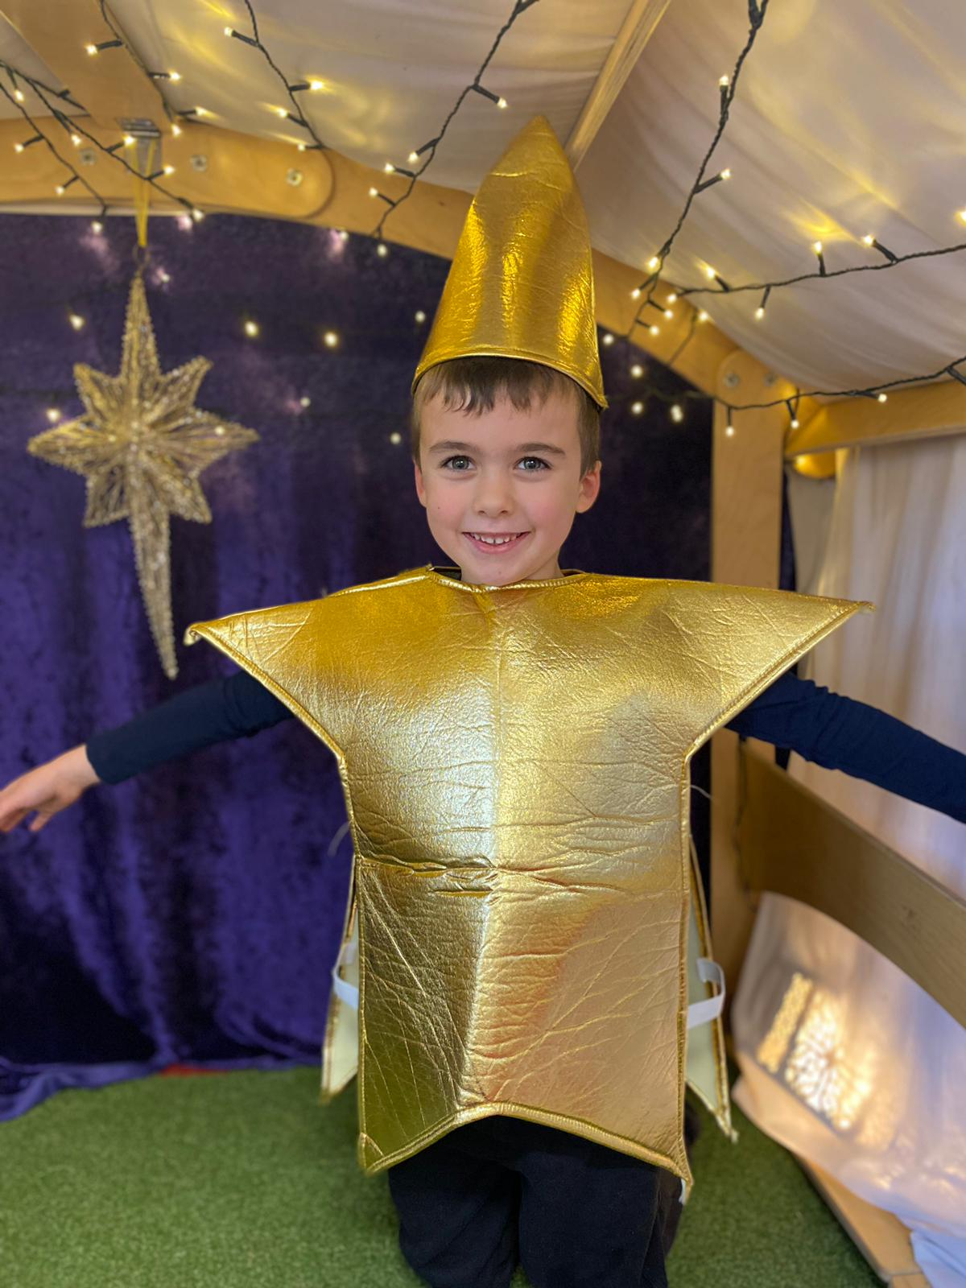
This is a star, twinkling brightly in the night. It wasn’t just any old star. In fact, it was very special. It had an important job , to help the kings.

Slide 22
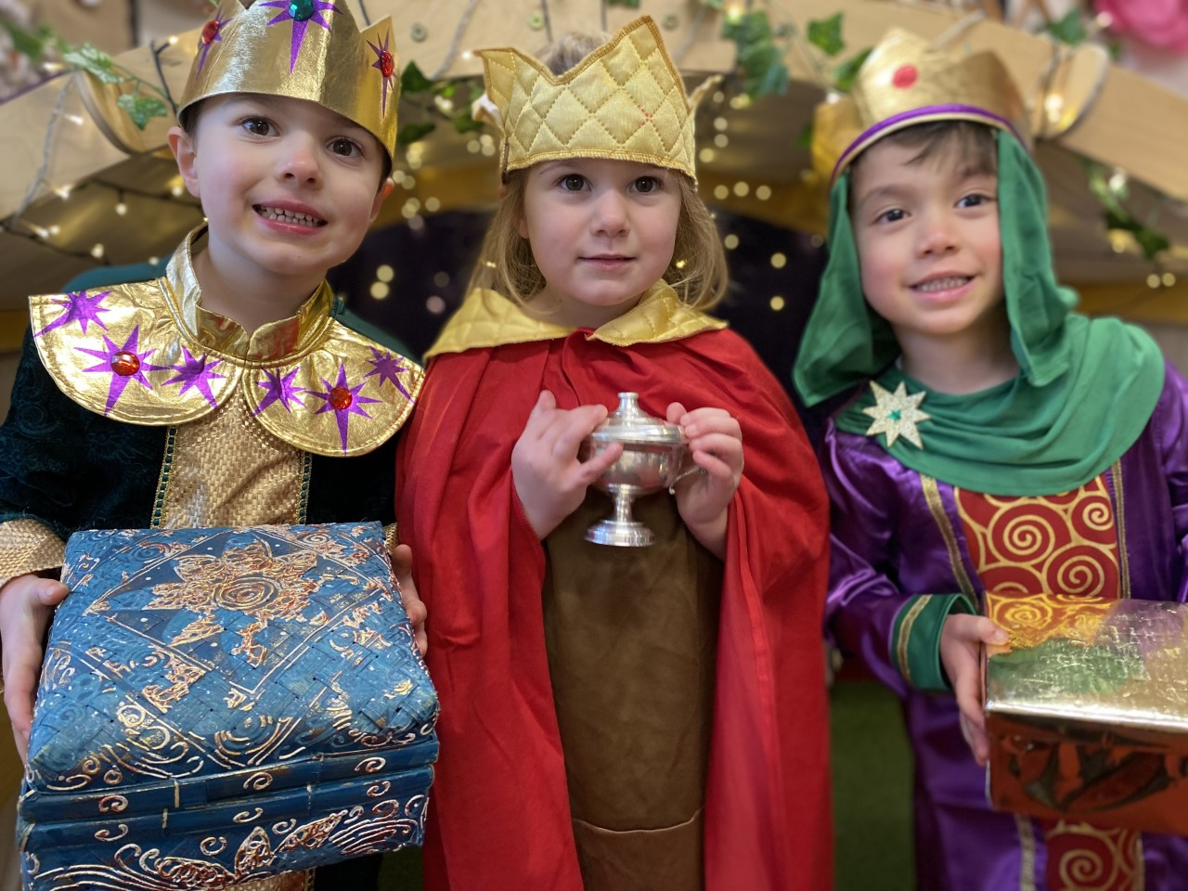
Visitors from the East
The kings had been studying secretly for many years and they knew what this very special star meant.

Slide 23
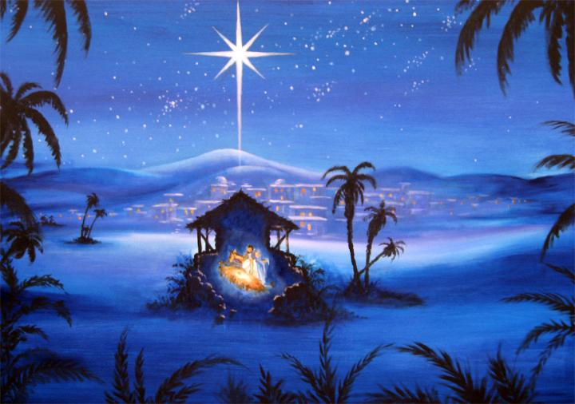
The star went before them and came to rest, over the place where the child had been born.
A stable! It must be a mistake.

Slide 24
When the kings saw the baby, they knew they were in the right place, and they were full of joy.

Slide 25
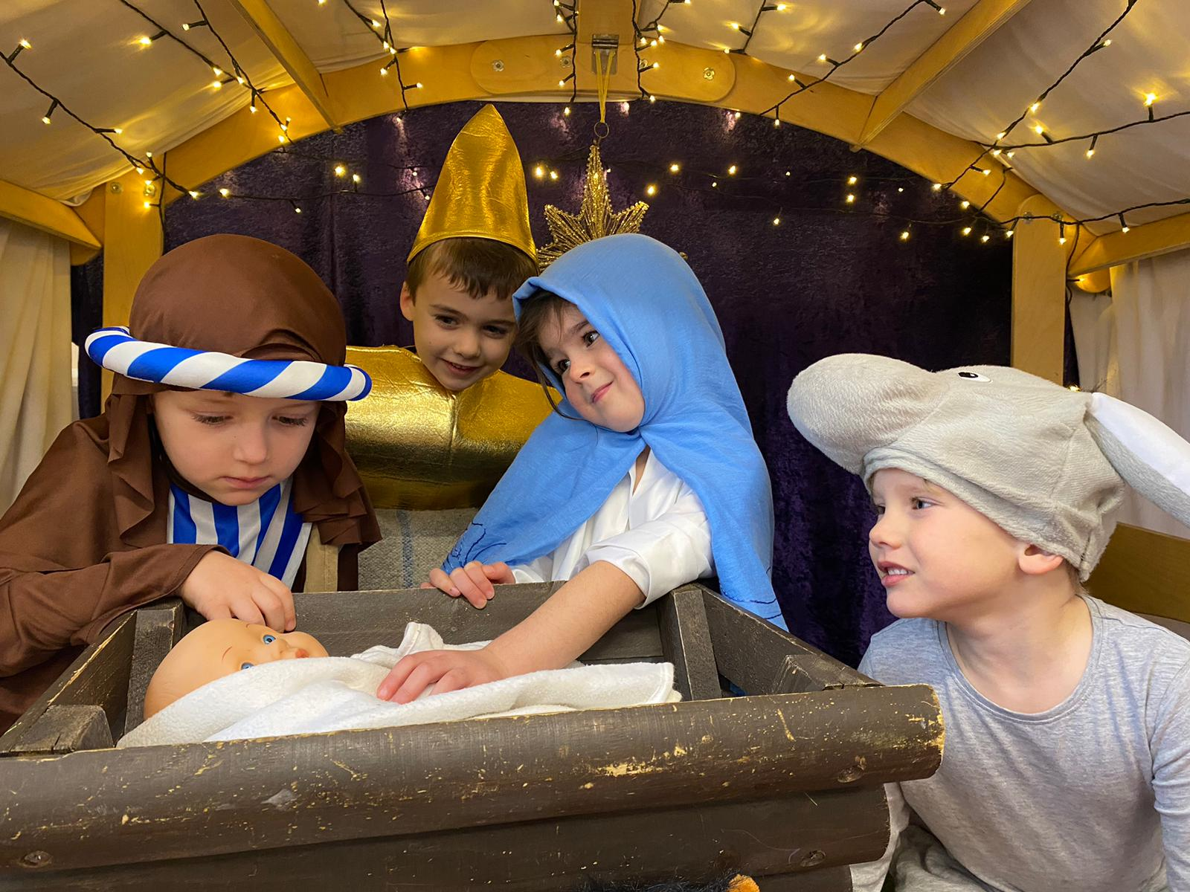
Radiant beams from thy holy face, Jesus,
Lord at thy birth.

Slide 26
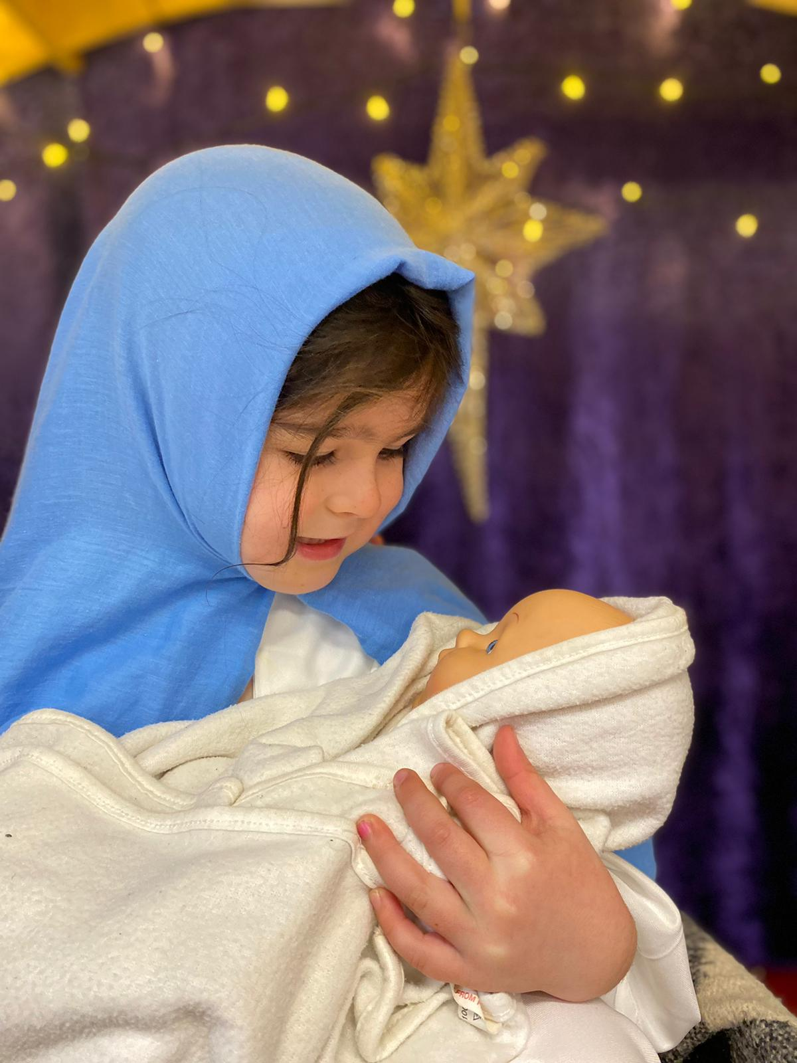
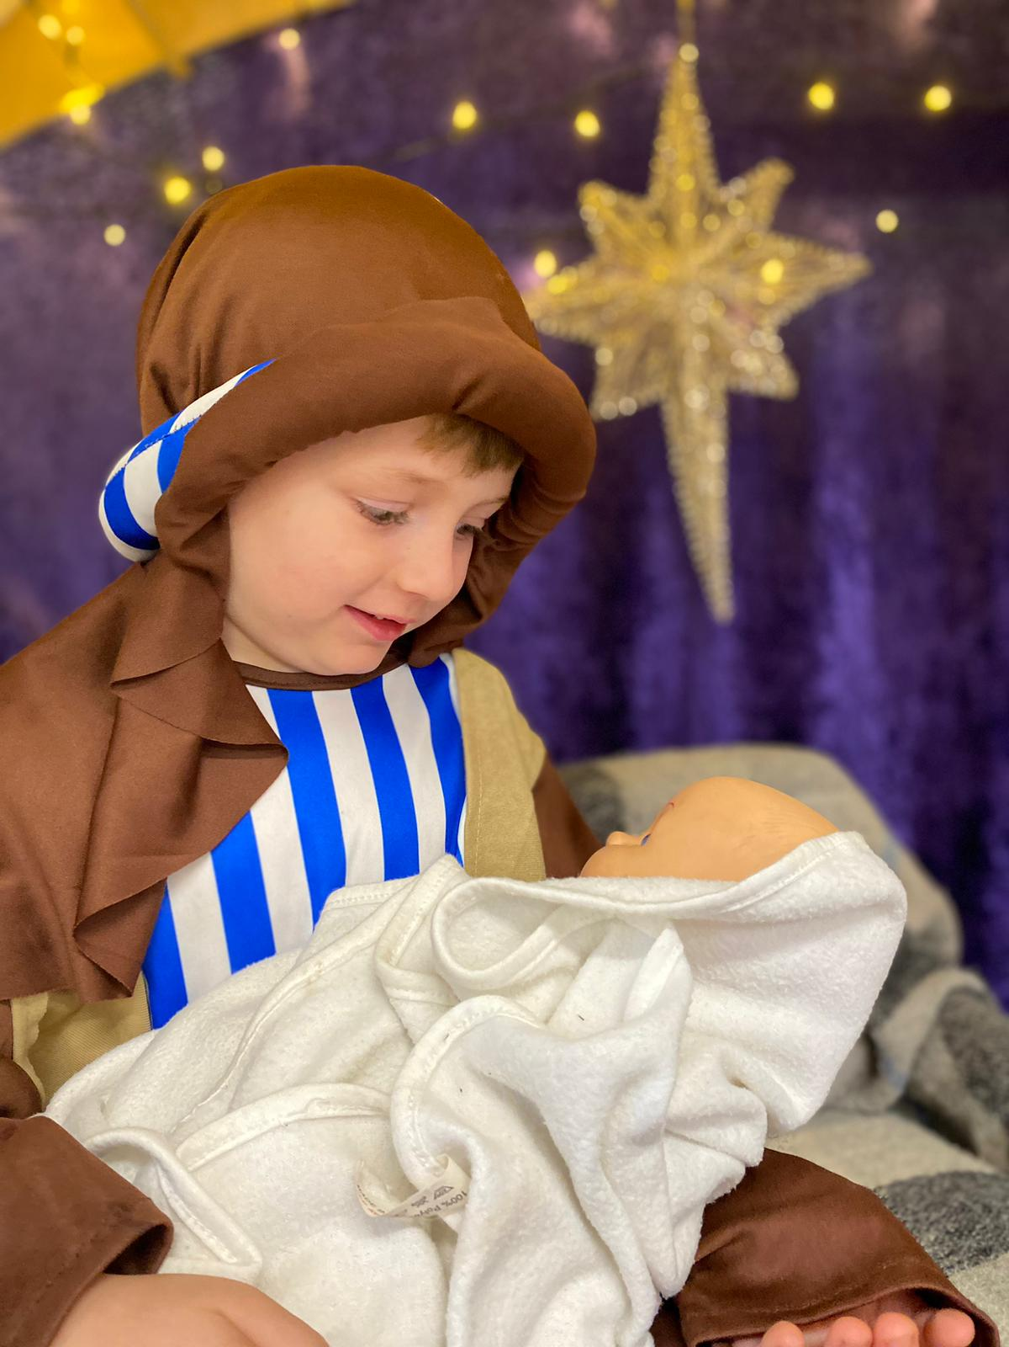
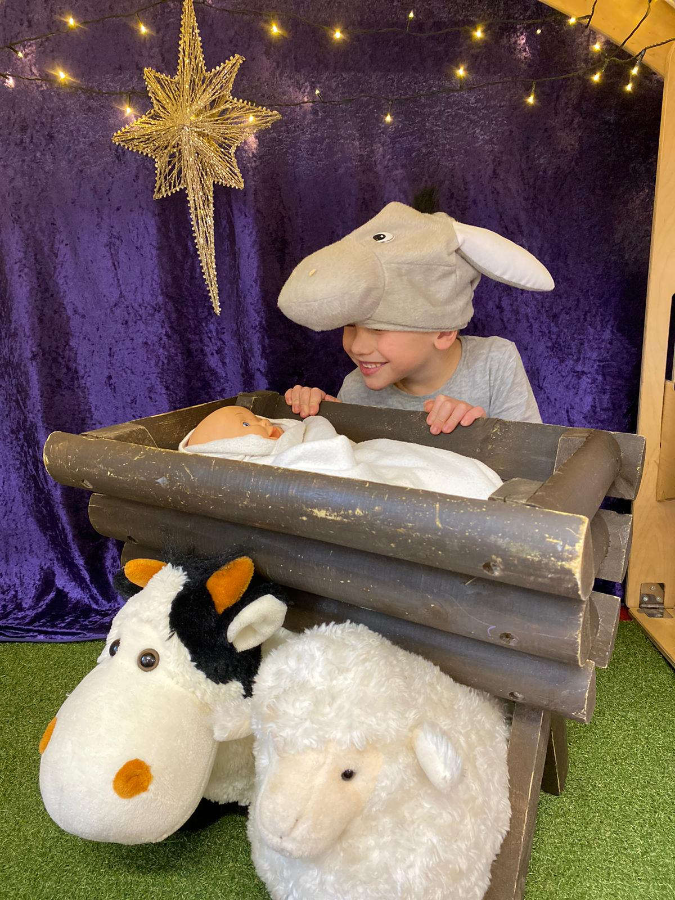

Slide 27
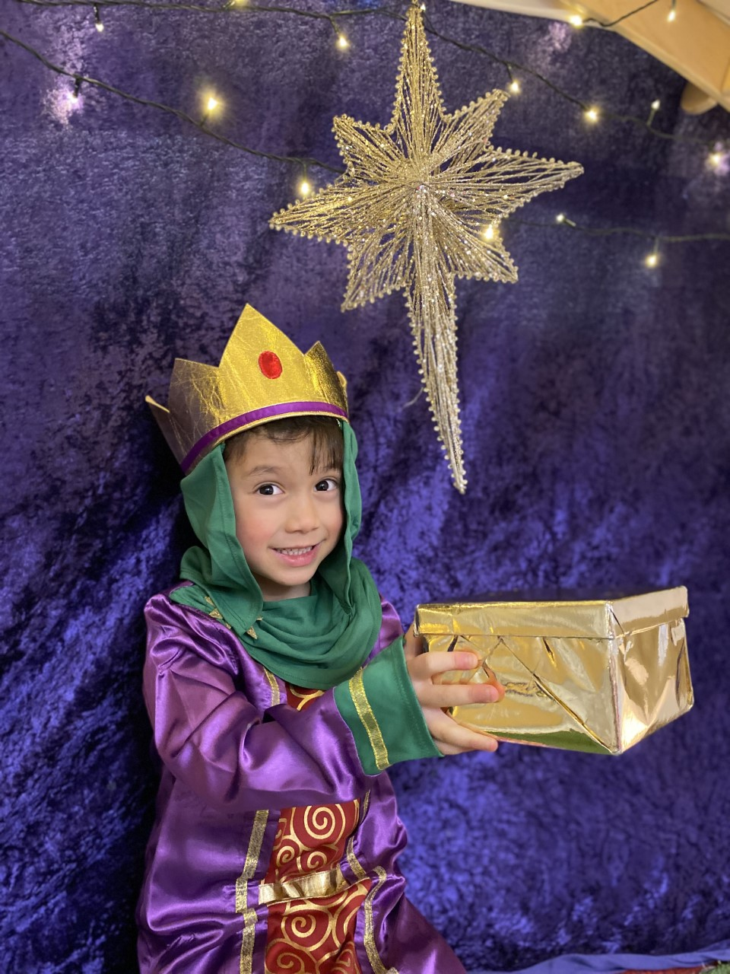
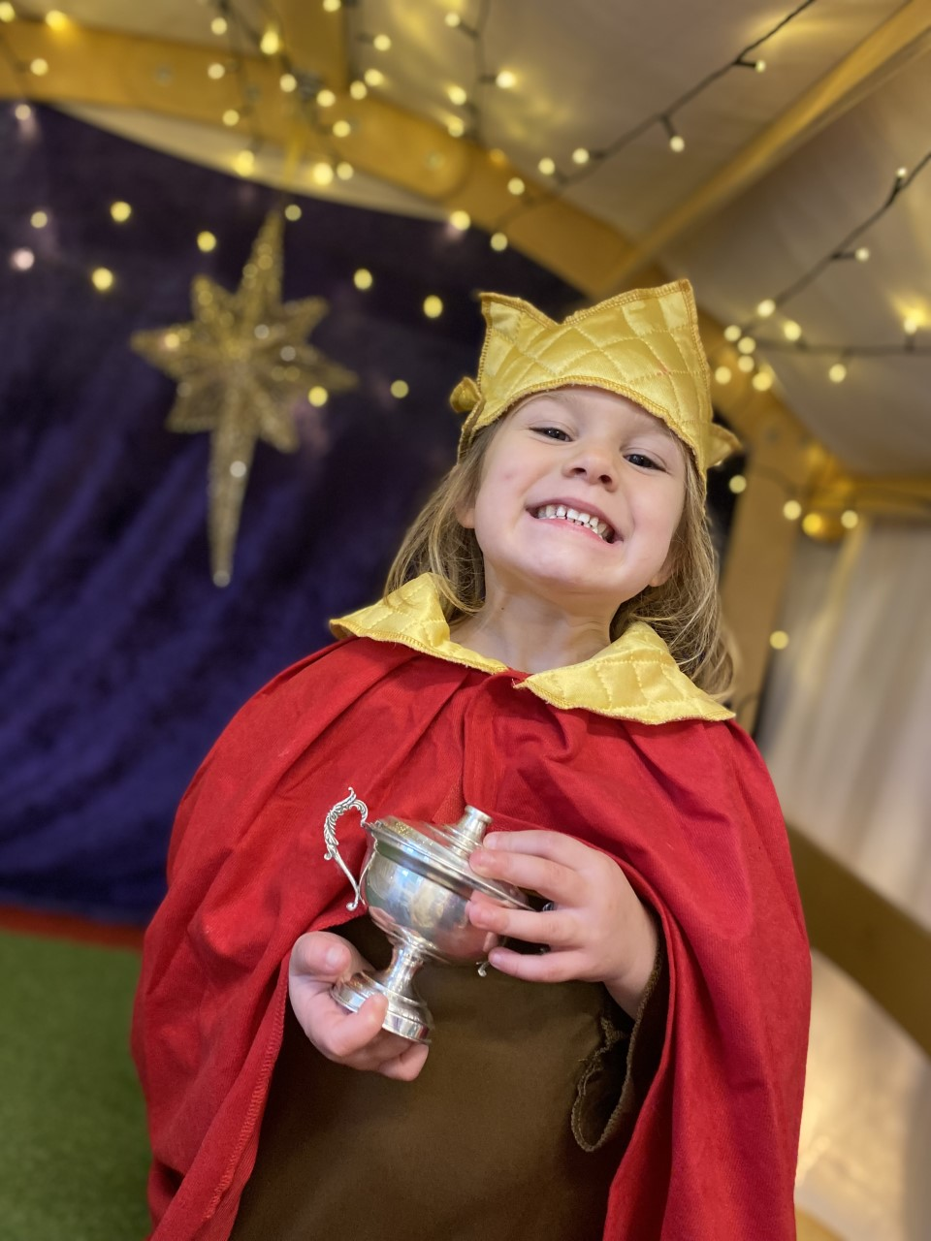
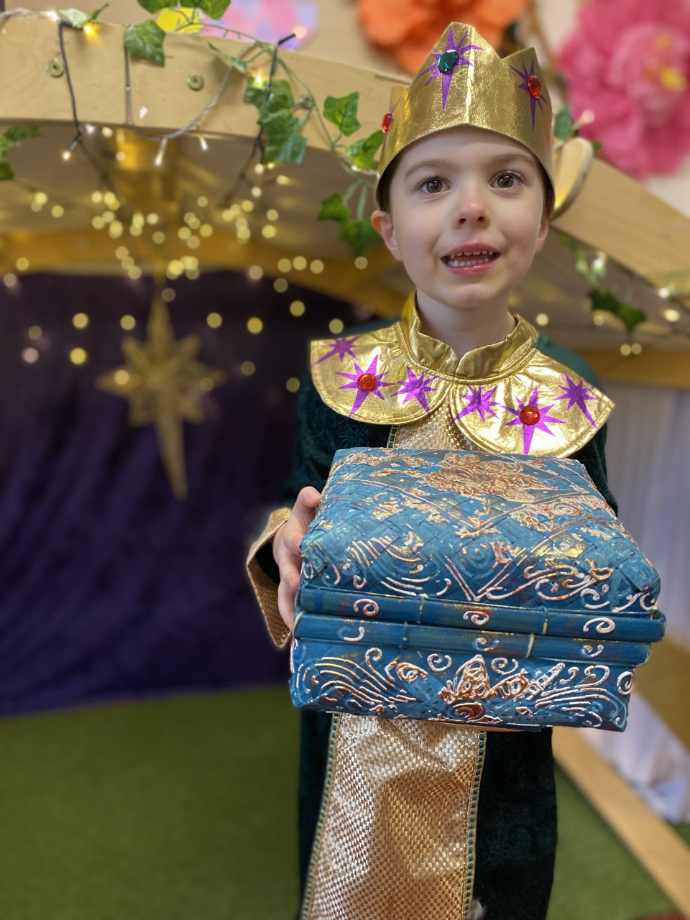
They opened their treasures and offered him…….
gifts of gold, frankincense and myrrh

Slide 28
Isaiah 9:2
‘The people who walked in darkness
have seen a great light.
They lived in a land of shadows,
but now light is shining on them.’

