Slide 1
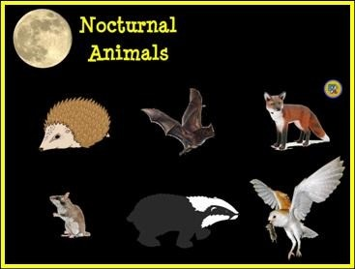
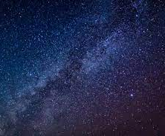
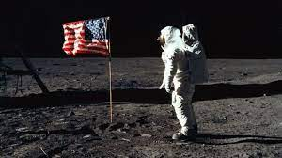
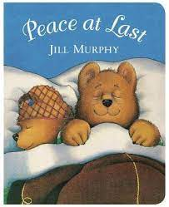
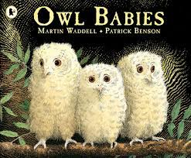
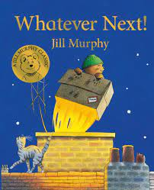
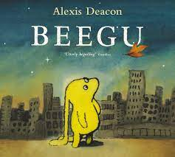
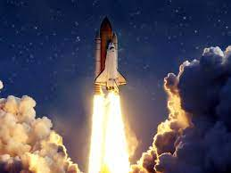
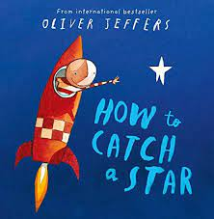
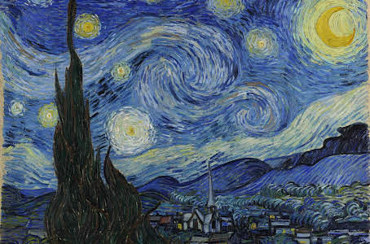
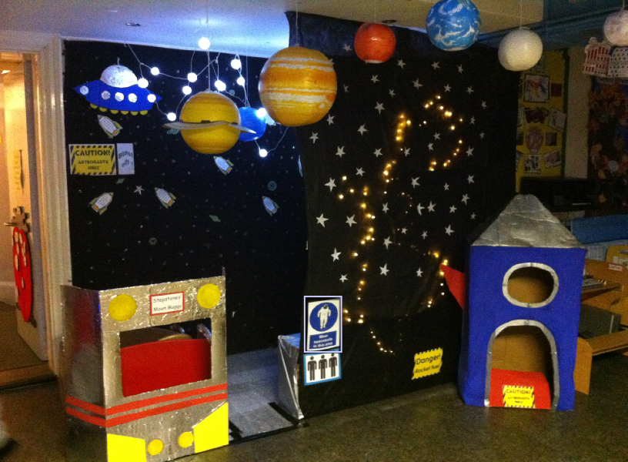
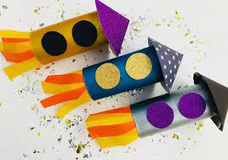
Starry Night
This project explores the differences in the world at night compared to during the day. It teaches children about the importance of a good night’s sleep, and helps them to discover what is happening in the world while they are sleeping, including finding out about nocturnal animals
Big question – What happens when I sleep?
Science and Technology
Which animals come out at night?.
Comparing day and night sounds.
How are shadows made?
Explore and describe electrical and non-electrical light sources.
How does the moon change?
Health and Wellbeing
There are adults in our community who work at night-time to help us
Bed-time routines
Discussing feelings about the dark.
Mathematics and Numeracy
Explore addition and subtraction with numbers to 10.
Double quantities within 10 and explore how to share amounts evenly.
Explore the composition of numbers to 10 and compare numbers.
Counting forwards and backwards.
Humanities
Stories from the past , moon landings.
Different seasons , shorter days, longer nights.
Language, literacy and Communication
Talk about stories, characters and settings and make connections with events in their own lives or other familiar stories.
Expressive Arts
Create their own Starry night pictures
Construct simple structures and models using a range of materials = space rockets and buggies
Singing lullabies
Space Role Play Area
Glossary
Day, night, dark, light, moon, stars, space, seasons, rocket, nocturnal, night shifts, health, sleep.

