Slide 1
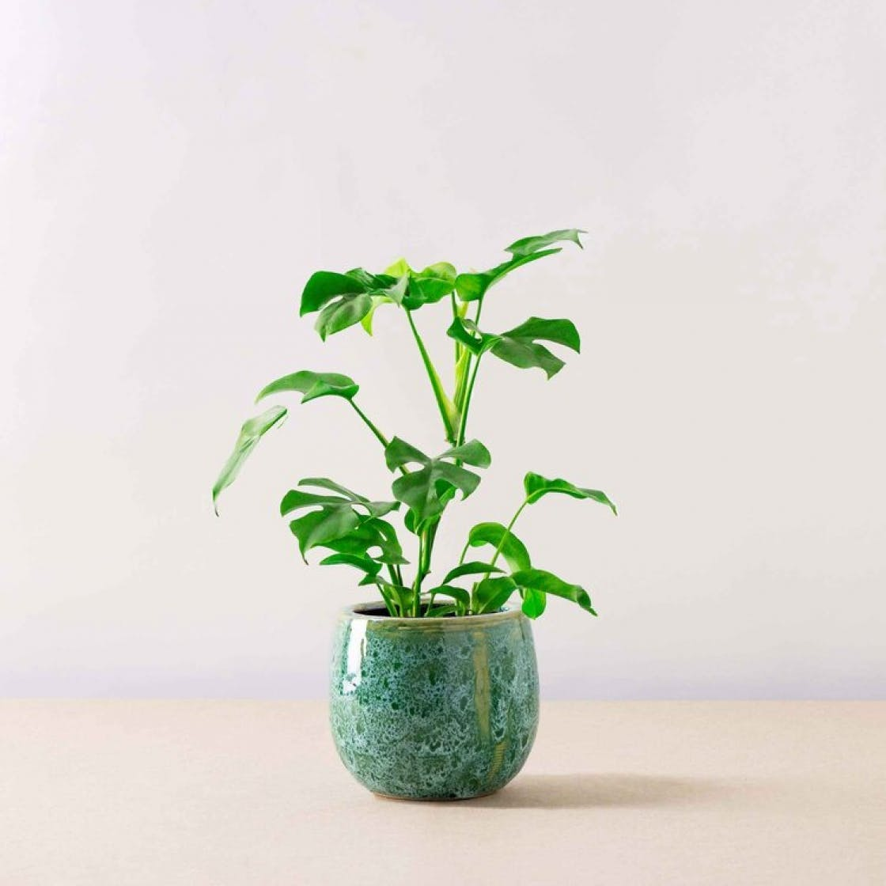


Our eco school
By Cora

Slide 2
Active travel in the school
If you live to far away from the school but you still want to walk then the eco warriors have a solution for you .On the tracker there is a button called the park and stride button. How is works is if you park 10 minutes from the school then walk the rest you are doing the park and stride and when you are doing the travel tracker in your class you can put that you did park and stride.
If you cant remember the password to the tracker please ask one of the eco people in your class.

Slide 3
The monitors
In your class you should have a electricity monitor and a tracker monitor, both should be from the eco group!
Every day the monitors need to do there job[doing the tracker and turning the lights and the computer of]
You can change the monitors whenever you want ,each week or whenever you want to but they have to be from the eco group

Slide 4
The app
All teachers know the password to the travel tracker: ankle-shush-deity
The app should be on your class Ipad, the teachers Ipad or shown on the interactive screen.
All you have to do is search on safari travel tracker or active travel (this should be what the monitor does).
Sign into the app then give the Ipad to the first person on the first table
When you are finished you don’t need sign out because you have tomorrow to do!

Slide 5
Hope that you keep this up in your class
I hope that you tell your teacher that you need to this.
I hope that you stick to doing this.
I hope that you get the award for being the most active class.
That is what we are striving for. We are striving for each class to have the most exercise each month .Try your very hardest to do other things than drive to school.

