Slide 1
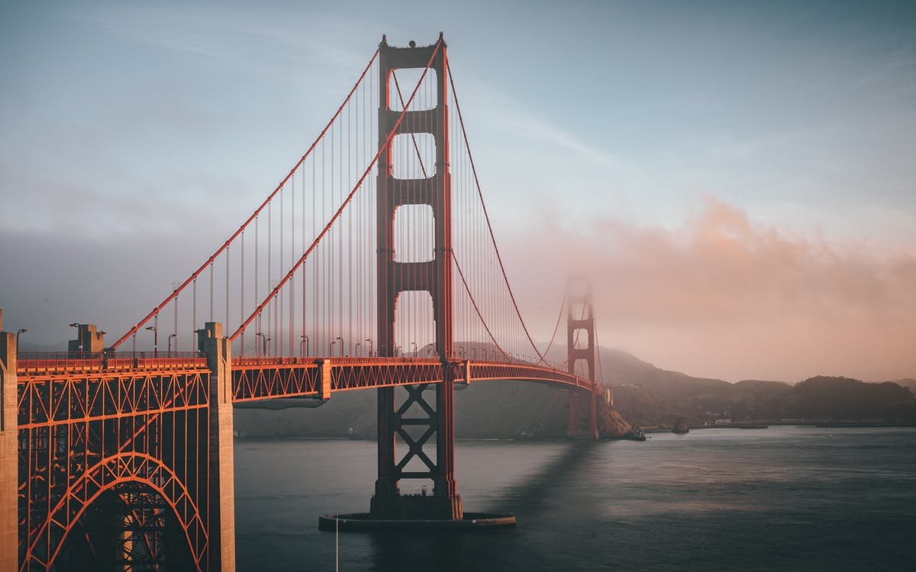

Slide 2
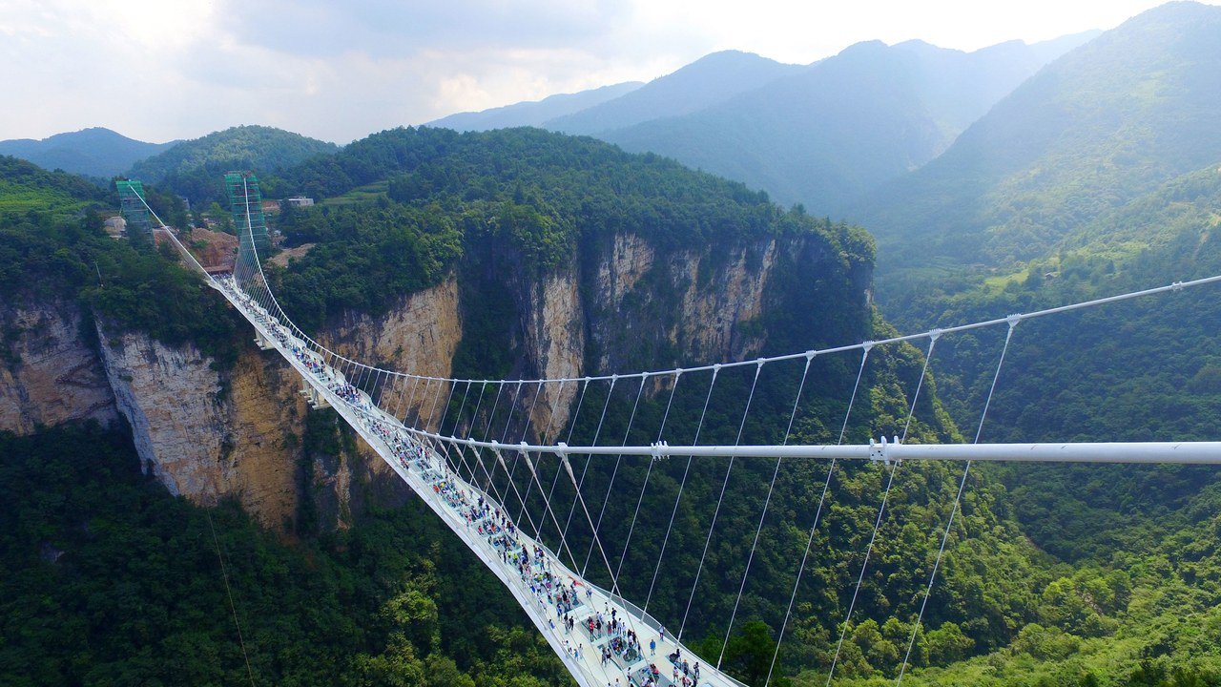

Slide 3
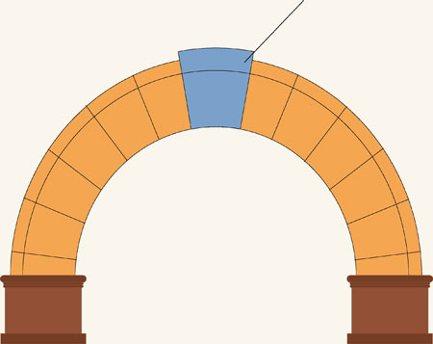
The arch bridge is the strongest bridge structure.
There are lots of pieces that have to come together to make it this strong. This is a lot like our friendships, there are lots of things that we have to do to be good friends and to build strong relationships.
The blue block in the picture is called the keystone.
For us, the keystone in our relationships is God. It is God and God’s love that makes us strong and leads us to make the right choices so that we can be good friends.
But what about the other blocks? What other qualities do we need to have to make strong relationships?

Slide 4
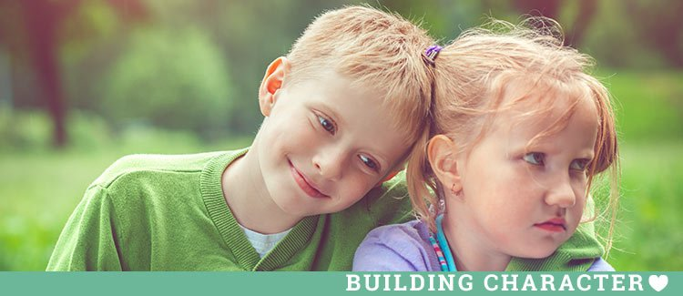
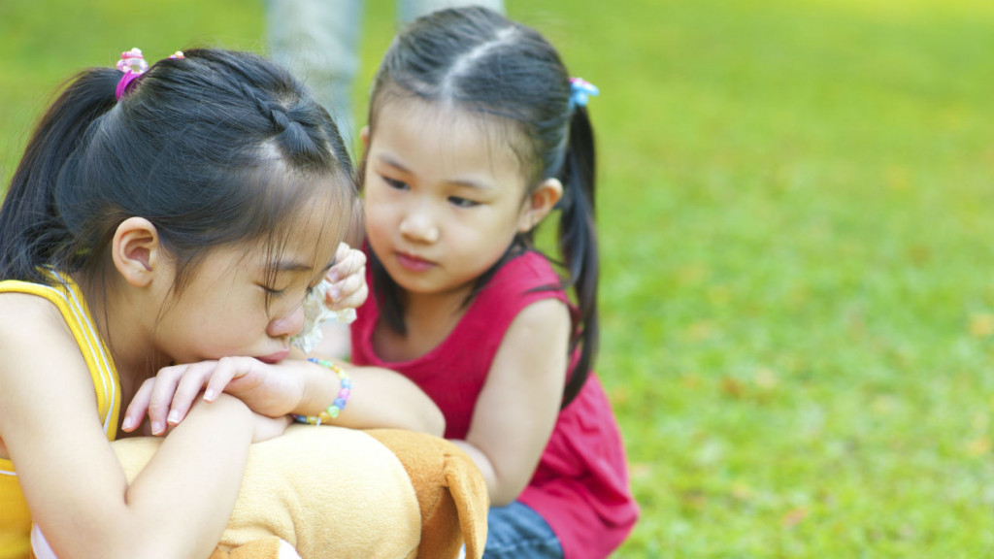

Slide 5
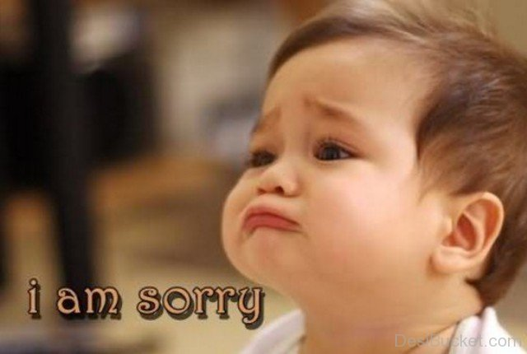

Slide 6
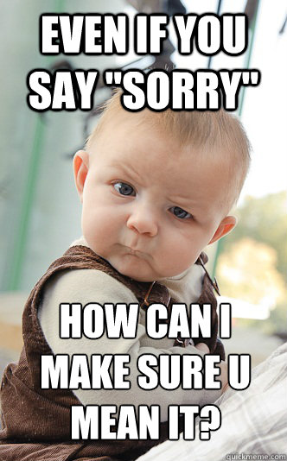

Slide 7
When we have made a bad choice and have fallen out with our friends we need to begin to build our friendship up again.
It takes both sides to come together and build a bridge and say sorry.
The bridge shows that we can overcome arguments and that we can still be friends,
Do you need to start building a bridge with someone?

Slide 8
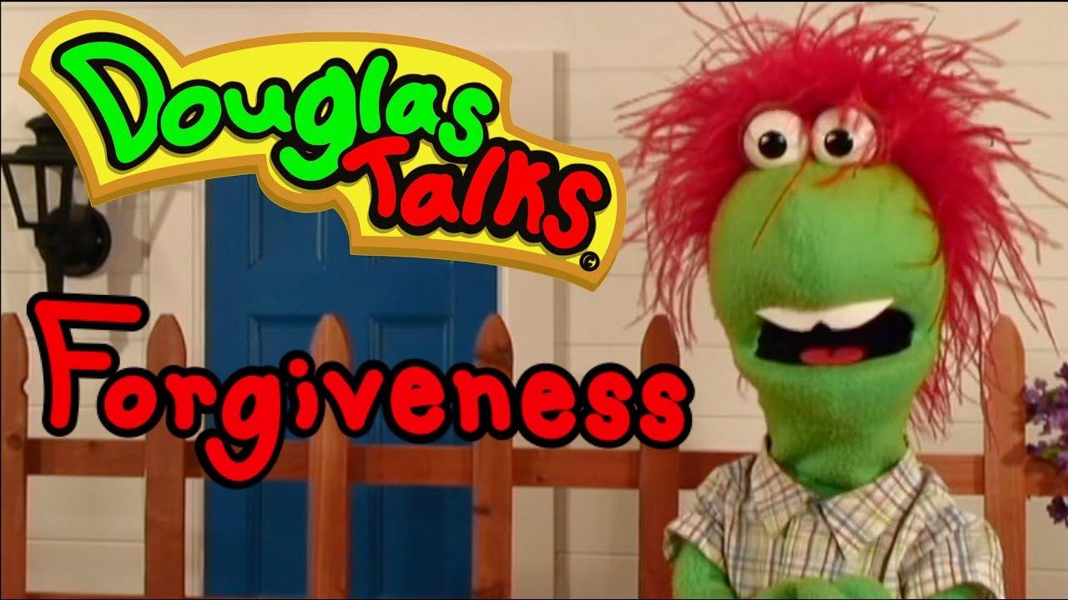

Slide 9
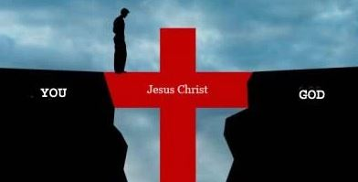
No one has greater love than this, to lay down one’s life for one’s friends.
(John 15:13)
Sometimes we make bad choices . It can be difficult to admit that we are wrong and to say sorry, but God is always there to help us and to support us when we need a friend.

Slide 10
Reconciliation
Friends
Healing
Rules
Being sorry
Freedom
and responsibility
Building Bridges
Choices

