Slide 1

Come and see Explore Assembly

Slide 2
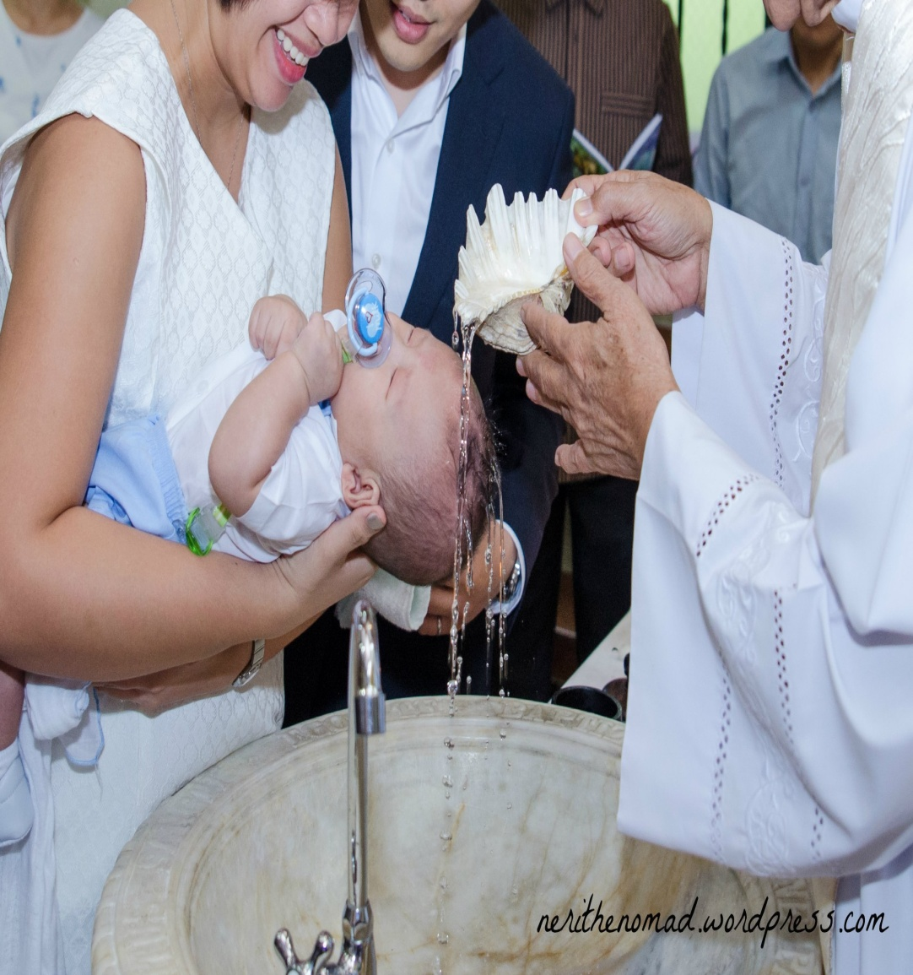
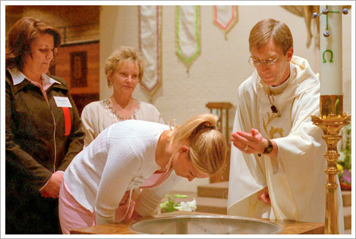
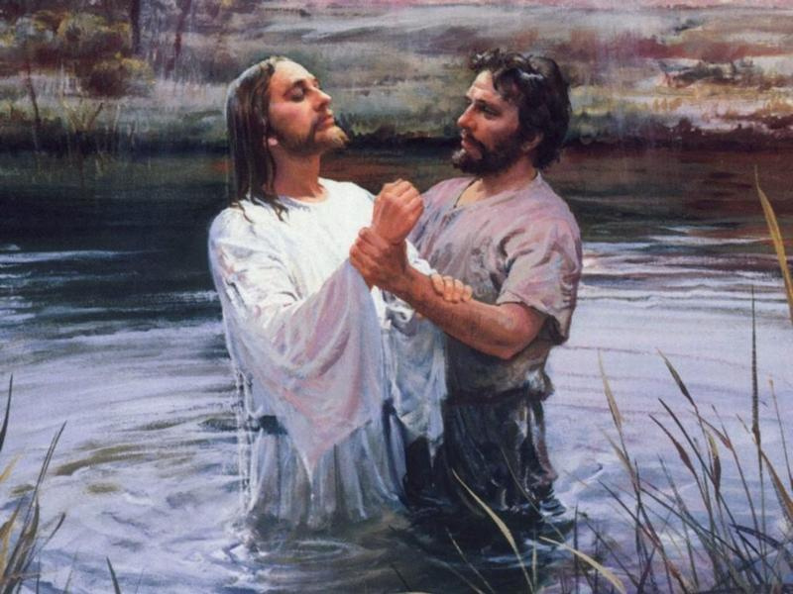

Slide 3
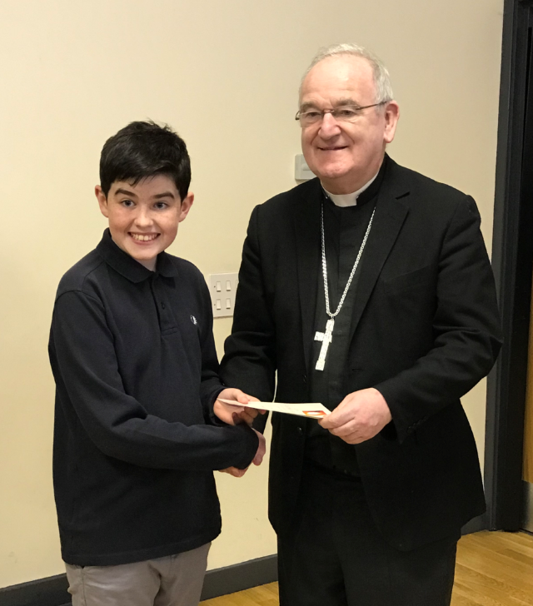
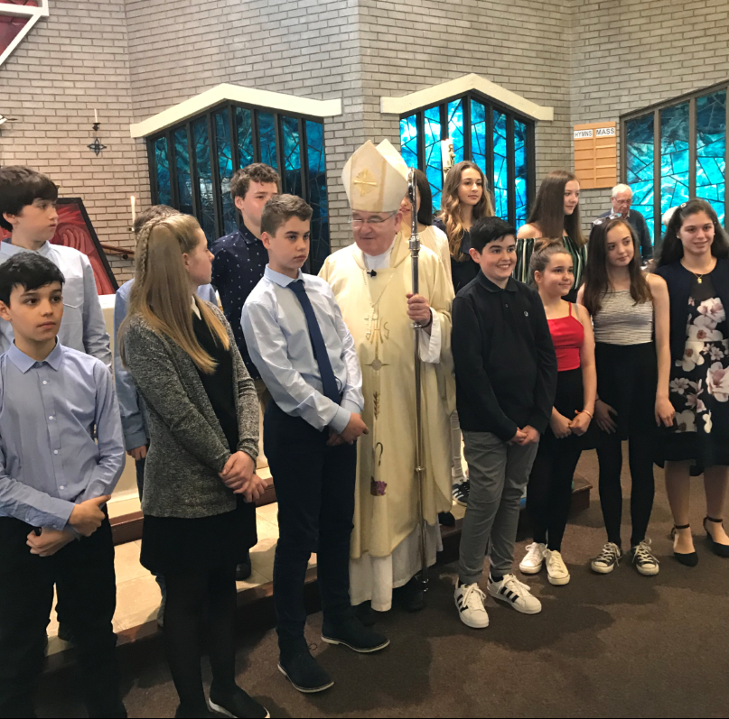

Slide 4
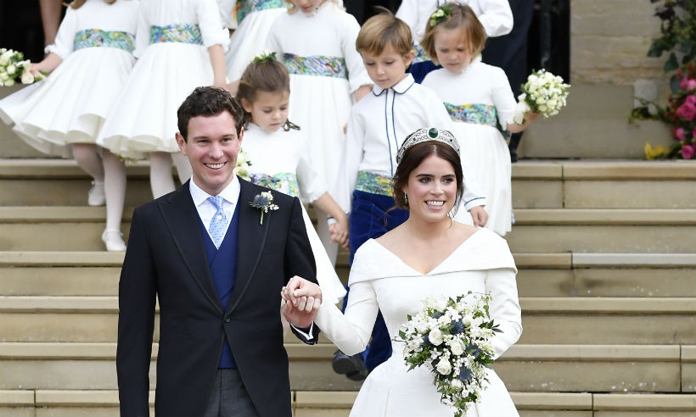
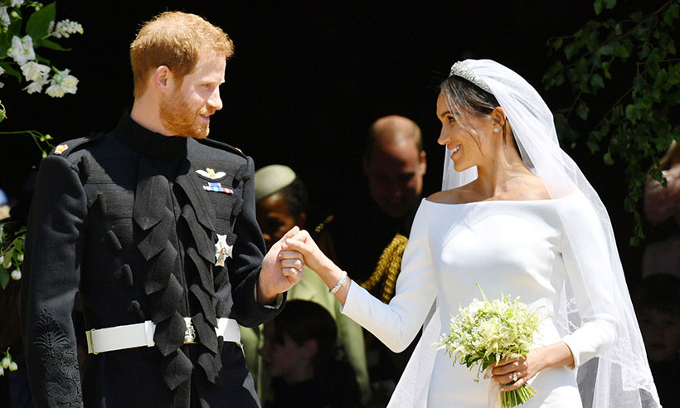

Slide 5
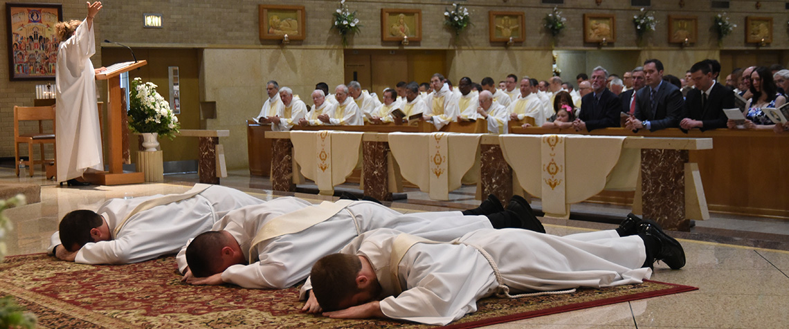

Slide 6
What do all these images have in common?

Slide 7
Listen
A Reading from the Holy Gospel according to Matthew
Glory to you, O Lord
There once was a man named John the Baptist, who actually was one of Jesus' cousins.
When people heard that John was in the area they would come from all over to listen to him and get baptized.
When someone believes in God, baptism is a way of showing others that you believe in Him and want to live your life the way God wants. When you get baptised, it's a special way of showing that you understand that you have and need God's forgiveness.
When some men named the Pharisees and Sadducees came to listen to John he had a strict warning for them: they needed to feel bad for the wrong things they had done and ask forgiveness for their mistakes. But these men didn't think they were doing anything wrong, they weren't sorry, and so John would not baptise them.
As people were coming to John to be baptized, they were wondering if he was the Saviour they had waited for. John heard what they were saying and he told them, "I am baptising you now, but very soon someone greater than me will come. He is so great that if He asked me to carry His shoes it would be an amazing honour."
John continued to preach and baptise people until one day Jesus came by to be baptised. John didn't know what to say; all he thought was, "how could I, just a regular man baptize Jesus the Saviour of the world?"
John said to Jesus, "You should be baptisng me. I cannot baptise you Lord."
Jesus replied, "It's important that I do this now. I am ready and I want to be an example to others and show them that it's important."
So John took Jesus and baptised Him. He placed his hand on His back and laid him down into the water until He was covered. Then he brought Him back up again. As soon as Jesus was baptised the sky opened up and the Holy Spirit came like a beautiful white dove, and landed right on Jesus shoulder. Then a voice from heaven said, "This is my Son, I love him and I am pleased with him."
The Gospel of the Lord
Praise to you Lord Jesus Christ.

Slide 8
Early Years - welcome - Baptism: a welcome to God’s family Year 1 - belonging - Baptism: an invitation to belong to God’s family Year 2 - signs and symbols - Signs and symbols in Baptism Year 3 - promises - Promises made at Baptism Year 4 - called - Confirmation: a call to witness Year 5 - LIFE CHOICES - Marriage, commitment and service Year 6 - VOCATION AND COMMITMENT - The vocation of priesthood and religious life

Slide 9
Going Forth
Think:
We think about the keeping of promises:
how hard it is sometimes to keep them,
and how disappointed or upset we can get if they are not kept.
Have you ever said ‘I promise’, and not really meant it?
How can you keep your promises in future?
We end our prayer now ‘In the name of the Father..
Notes:
Teacher’s Notes: Ask the class now to think carefully about this question for a few moments. ‘If everyone in this room helped each other all the time what would it be like?

