Slide 1

...running a race

Slide 2
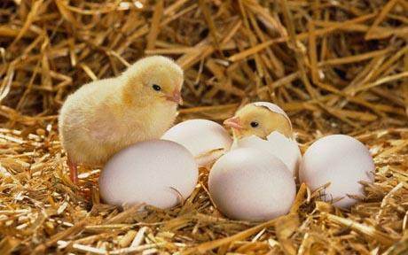
...chicks hatching from an egg

Slide 3
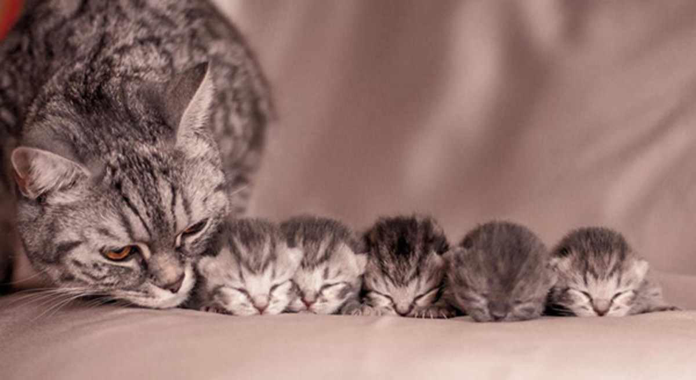
...new born kittens

Slide 4
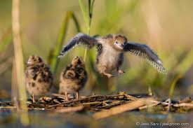
...learning to fly

Slide 5
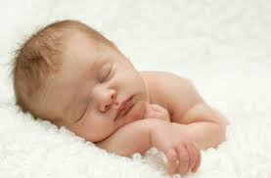
...new born baby

Slide 6
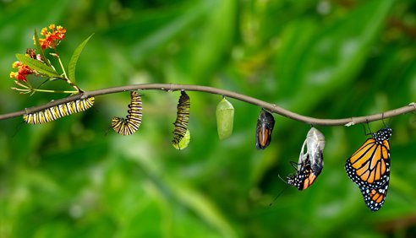
...caterpillar to butterfly

Slide 7

...Happy New Year

Slide 8
What do they all have in common?

Slide 9
Myself
Homes
Ourselves
Beginnings
Loving
People
Families

Slide 10

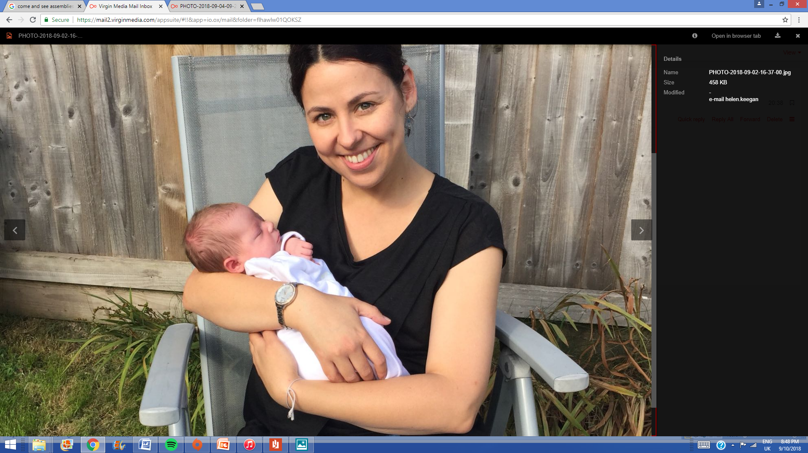
Family
A new beginning, new family, unique and loved.
God was with her from the very beginning, he will always be watching over her.

Slide 11
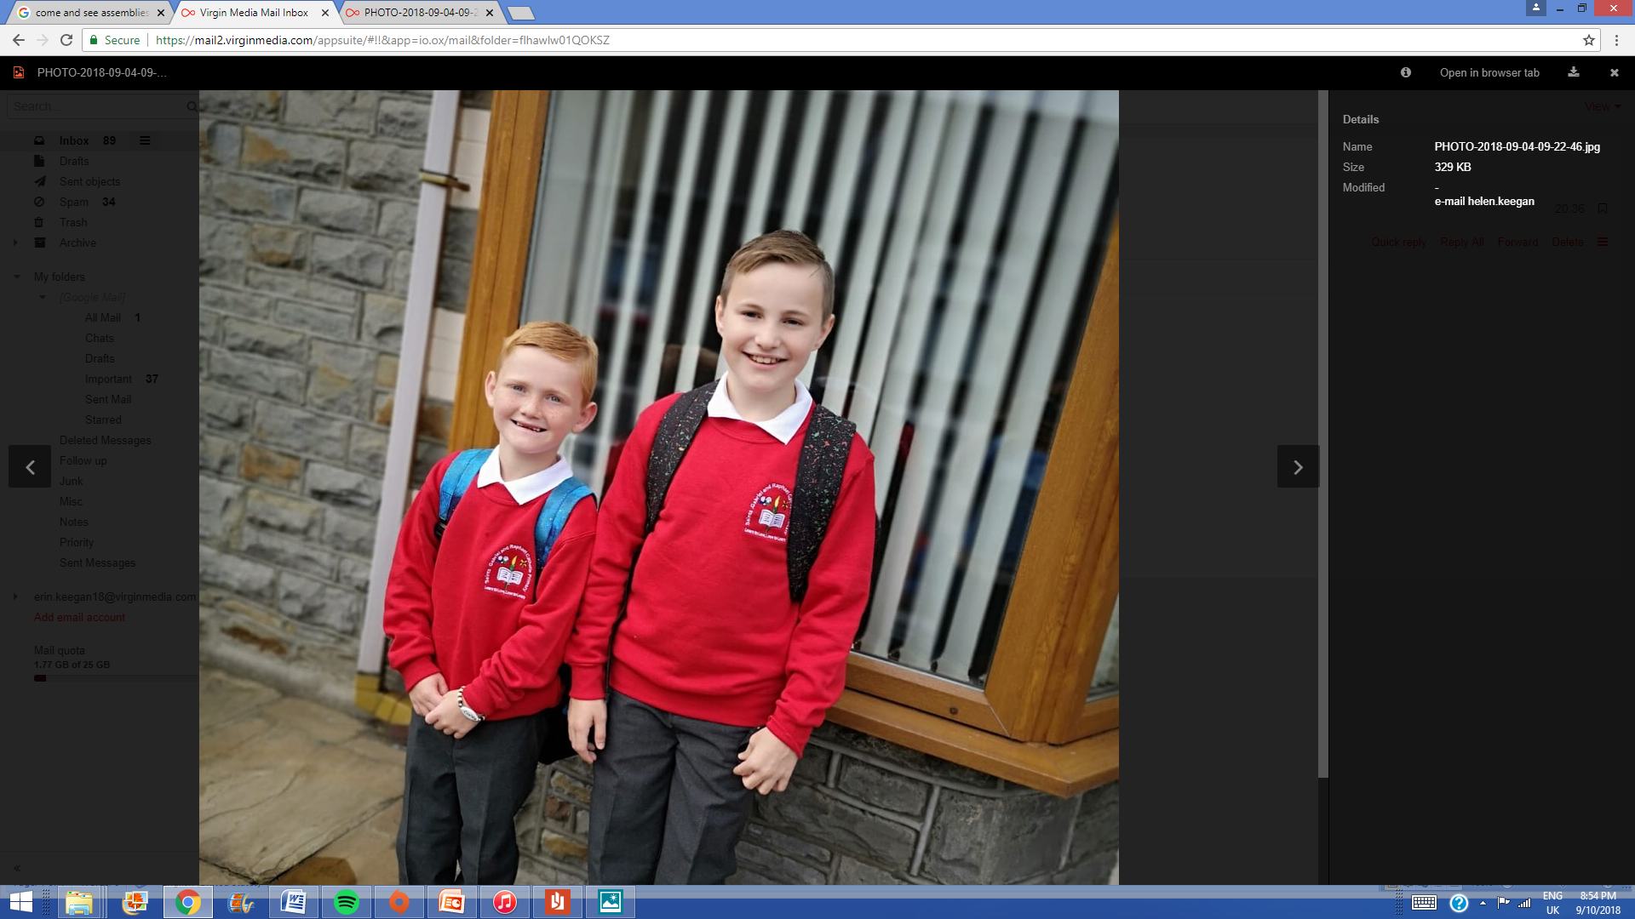
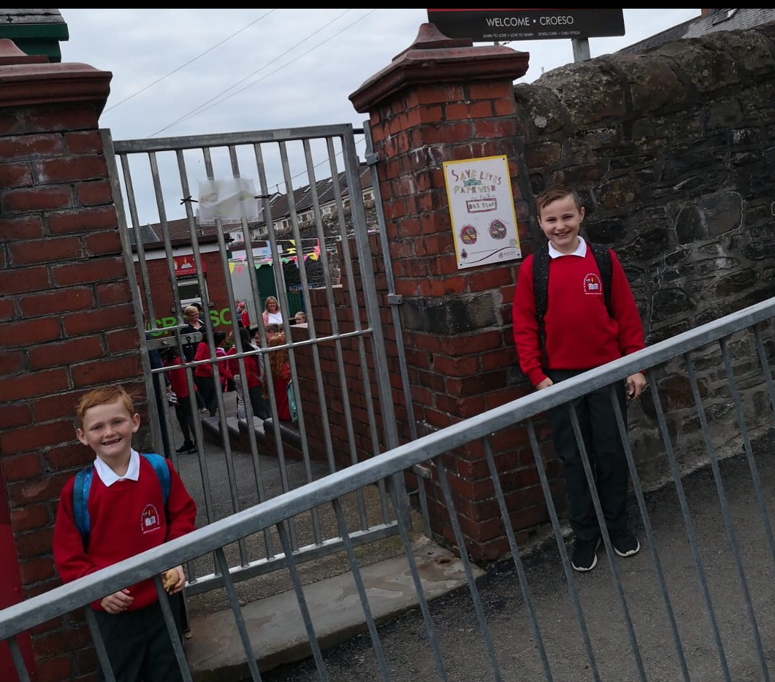
New Beginnings
Do you think they were scared? Was God watching over them ?

Slide 12
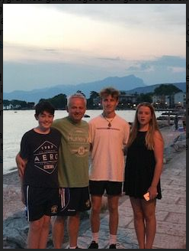
Do you think this is a loving family? Do they live in a happy home? Are they special to God?

Slide 13
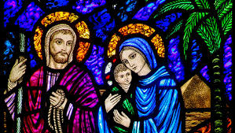
Do you know this family?

Slide 14
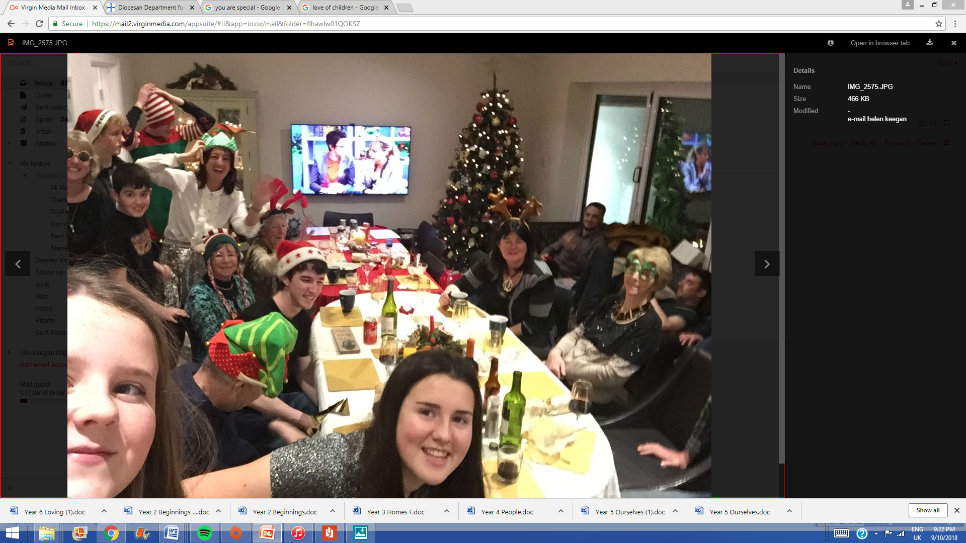

Slide 15


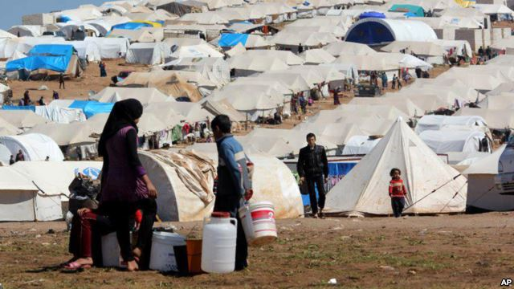

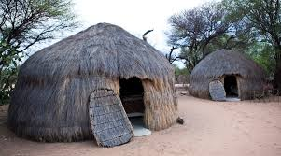
Homes
Are these homes all filled with love?

Slide 16


Slide 17
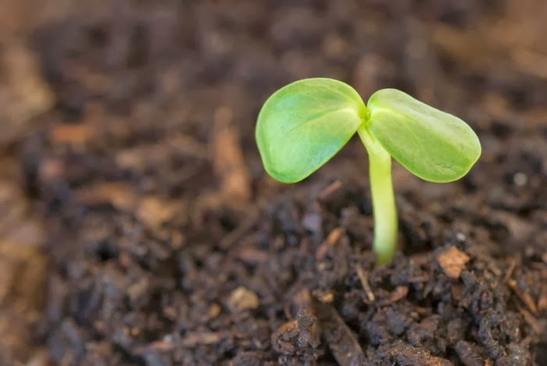
Listen
A Reading from the Holy Gospel according to Mark
Glory to you, O Lord
One day Jesus said:“The farmer goes out and scatters seeds on his field.
He goes about his business, getting up every morning and going to be every night.
And all the time the seeds sprout and grow. He doesn’t understand how they grow, he only knows they do.
First little shoots appear. The stalks grow up and up until at last the ears of grain are ready and the farmer gathers in the harvest.”
Then Jesus said: “That is the way God works!”
The Gospel of the Lord
Praise to you Lord Jesus Christ.

Slide 18
Response
What makes me unique?
Why am I precious?
How do I know God loves me?
The Big Questions
Who loves me?
Where do I come from?
What makes me unique?
Who are my family? How do families show love and care?

Slide 19
What does home mean to you?
To which family did Jesus belong?
How is God present in my life?
Does love last forever or does it have limits? Do you have to earn love? How can I love people I don’t like?
Why are some beginnings easy and some difficult? Will there be many beginnings in my life?

Slide 20

Going Forth
Think:
Every night before you go to bed for the next few days I want you to try to remember that God loves you, your family love you, you are special to God and your families, God is with you at every new beginning, he is with you in your home, your school during good times and hard times.
The sign of the cross is another prayer of the Christian family.
Let us try to remember every night for the next week to either say the ‘Our Father’ or make the sign of the cross before we go to sleep.
We end our prayer now ‘In the name of the Father..
Notes:
Teacher’s Notes: Ask the class now to think carefully about this question for a few moments. ‘If everyone in this room helped each other all the time what would it be like?

