Slide 1

Praise the Lord

Slide 2
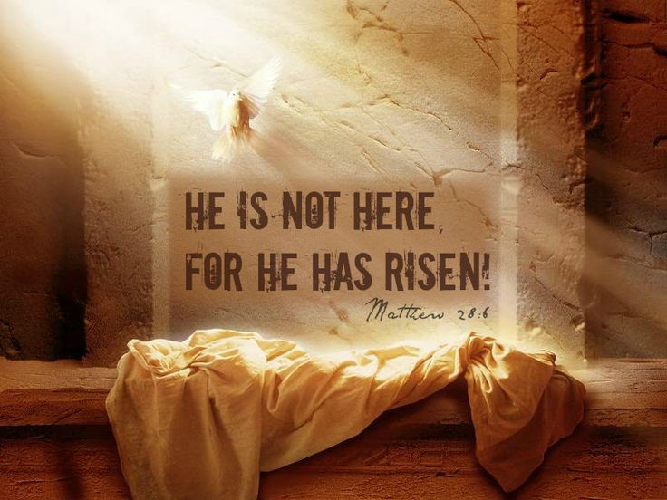

Slide 3
Good News
Energy
Spread the Word
Transformation
Holidays- Holydays
New Life
Witness

Slide 4
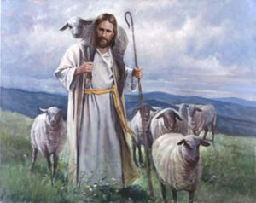
Good News
There is no news that is better than hearing that somebody loves us.
In this scripture we learn that Jesus loves us like a shepherd loves his flock of sheep.
Jesus loves us so much that He would die for us.
Think about the people that you love. Give them some good news today by telling them how much you love them.

Slide 5

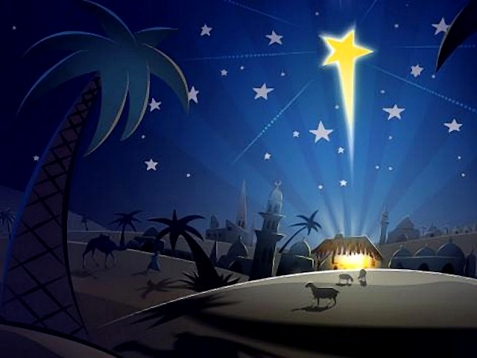
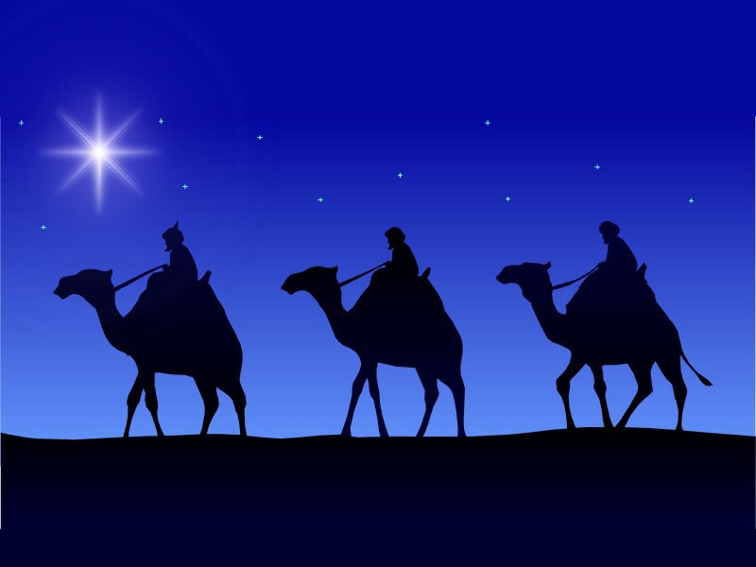
Holidays- Holydays
Pentecost is a holy day. It is the day when the Holy Spirit came down upon the disciples.
Jesus gave this message to His disciples before He ascended into Heaven:
The Helper, the Holy Spirit, whom the Father will send in my name, will teach you everything and make you remember all that I have told you.
John 14: 26

Slide 6
Energy
Transformation
Transformation is a big word and it explains how we can change from one thing into something which is hopefully a bit better. Think about the changes that you can make in your life so that you become a better person who is more like Jesus.
Worries can hold us back and sometimes the best way to move forward is simply to let them go. We should try to concentrate on being a more confident person instead of worrying about what other people think of us.

Slide 7
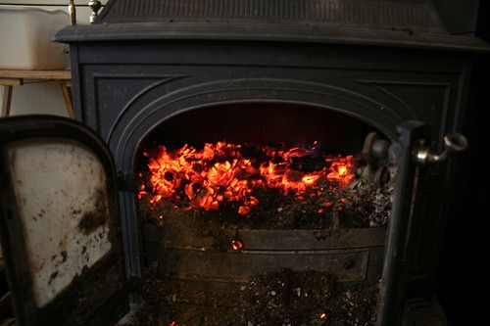

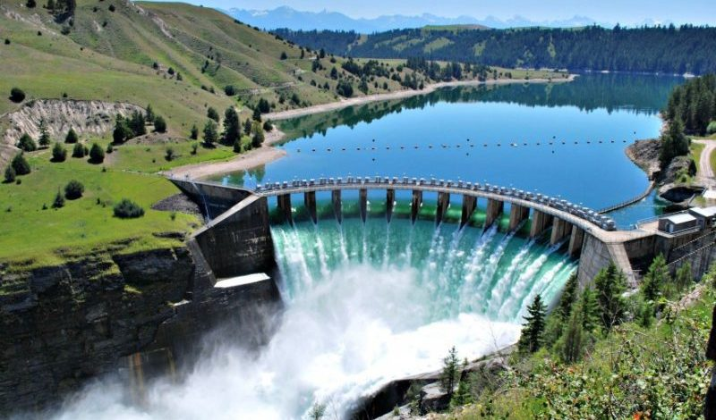


Slide 8
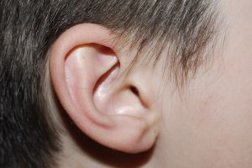
If clever scientists didn’t transform the sun and wind and waves into energy then we wouldn’t be able to use that energy for electricity.
We all have the potential to use our energy to do the good things that Jesus has asked us to do but we have to use the gifts that we have been given.
We have ears but we can make them so much more! We can use our ears to hear the Word of God. We can use our ears to listen to those in need. We can use our ears to listen for God’s call.

Slide 9
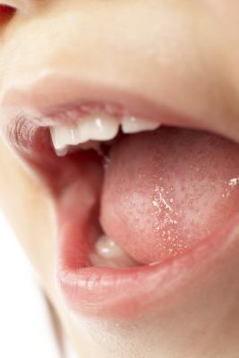
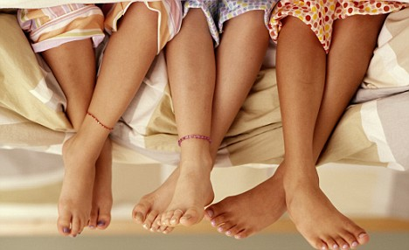
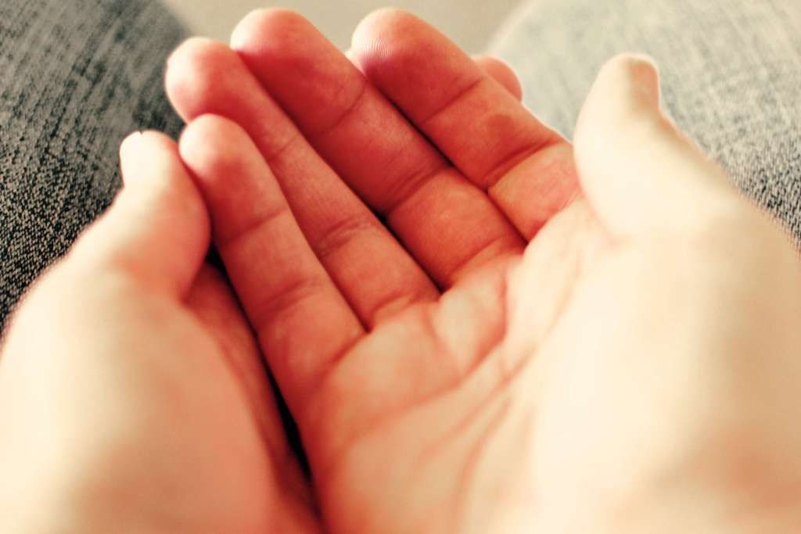
How you can transform them and use them for Jesus’ work?

Slide 10
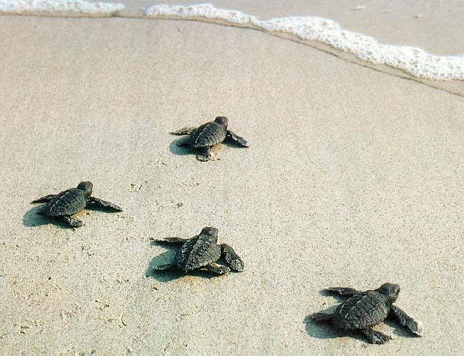
New Life
Witness

Slide 11
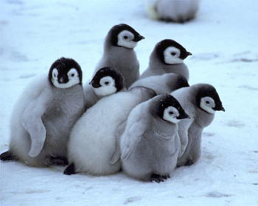
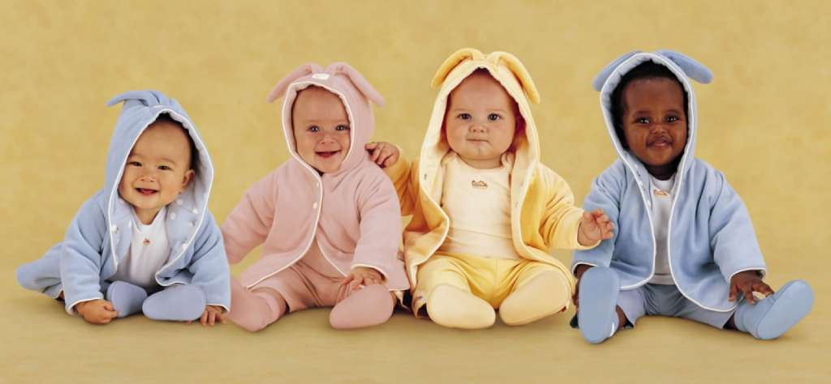
Where there is New Life we have the opportunity to help and to nurture it
God made us stewards of the Earth which means that we should take care of the plants, animals and people that are a part of it.
When we see New Life in the world we should take care of it and encourage it to grow so that we are fulfilling our call to God take care of the Earth and everything and everyone who lives on it.

Slide 12

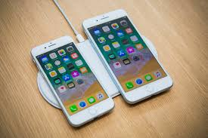

Spread the Word
If you were going to send a message about Jesus, what would you say?
Help us Lord to use more than our voices when we spread the Word of God.
Help us to communicate with others clearly so that we share a message of love.

Slide 13
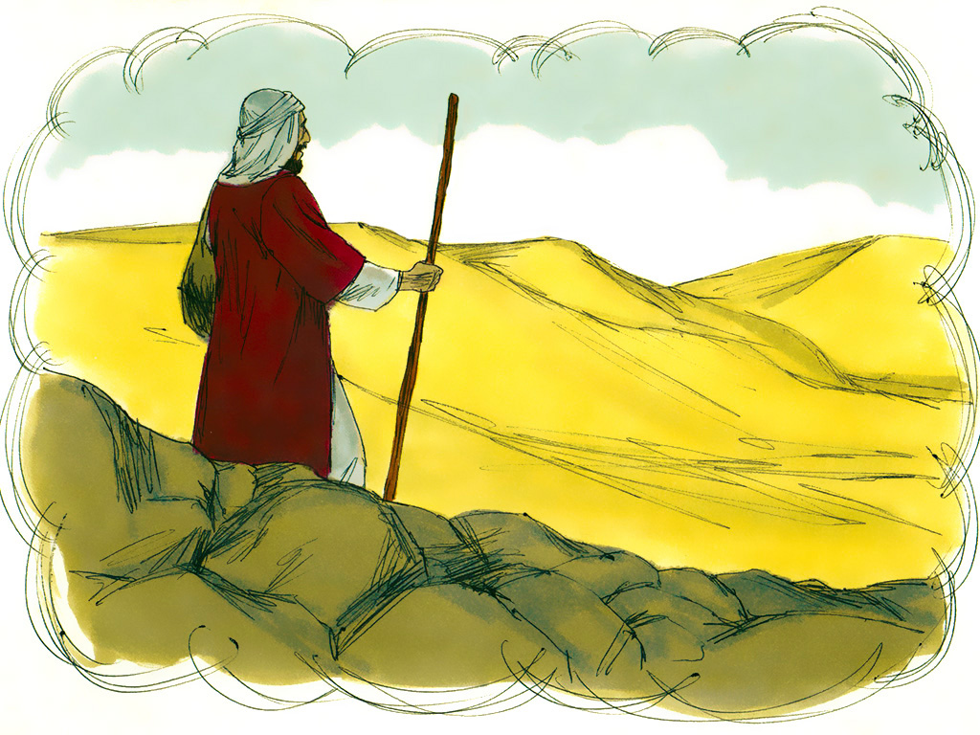
Notes:
Teacher’s Notes: Jesus told a story to explain his answer ‘There was once a man who was going down from Jerusalem to Jericho.

Slide 14
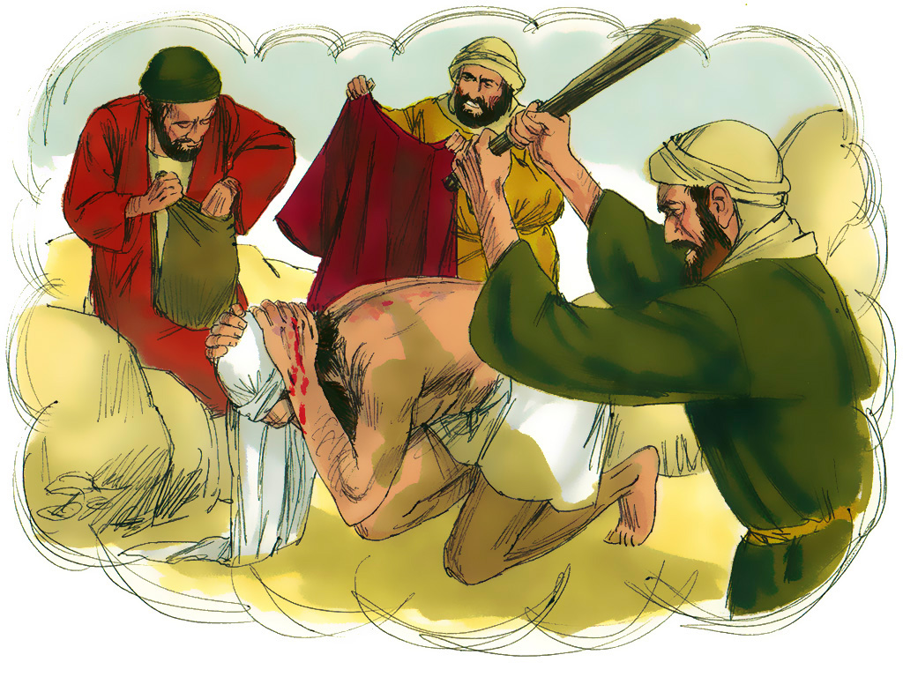
Notes:
Teacher’s Notes: ‘Robbers attacked him, took his robes, and beat him up, leaving him half dead.

Slide 15
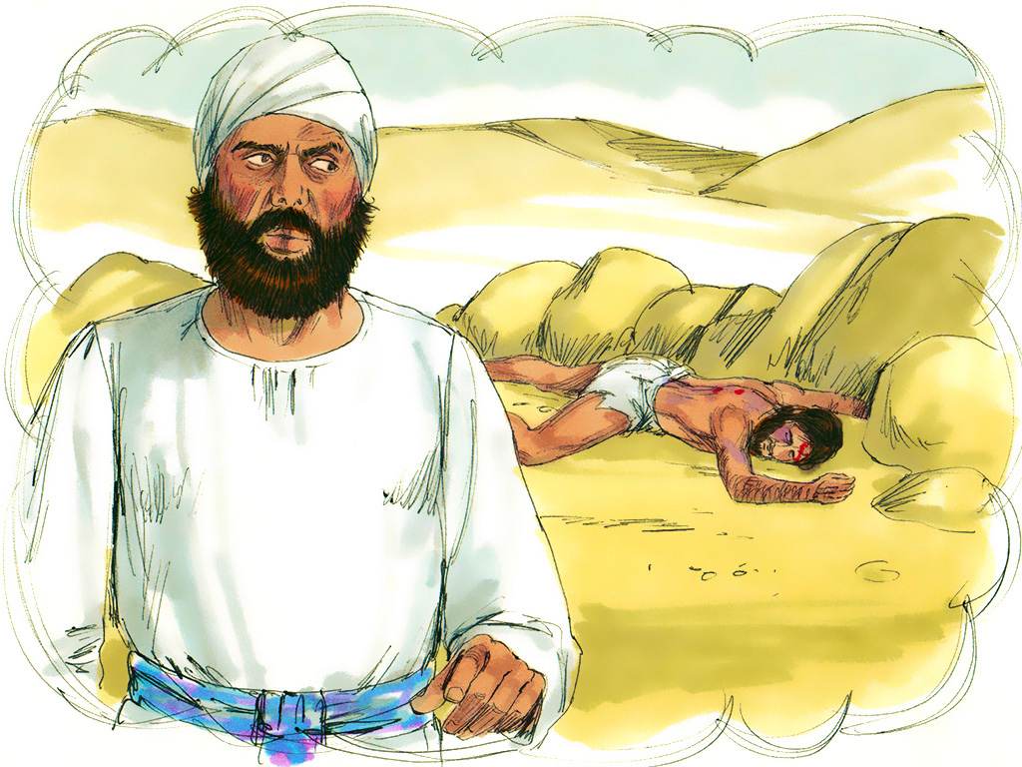
Notes:
Teacher’s Notes: ‘A little time later a priest was going down that road, but when he saw the man, he walked on by on the other side.

Slide 16
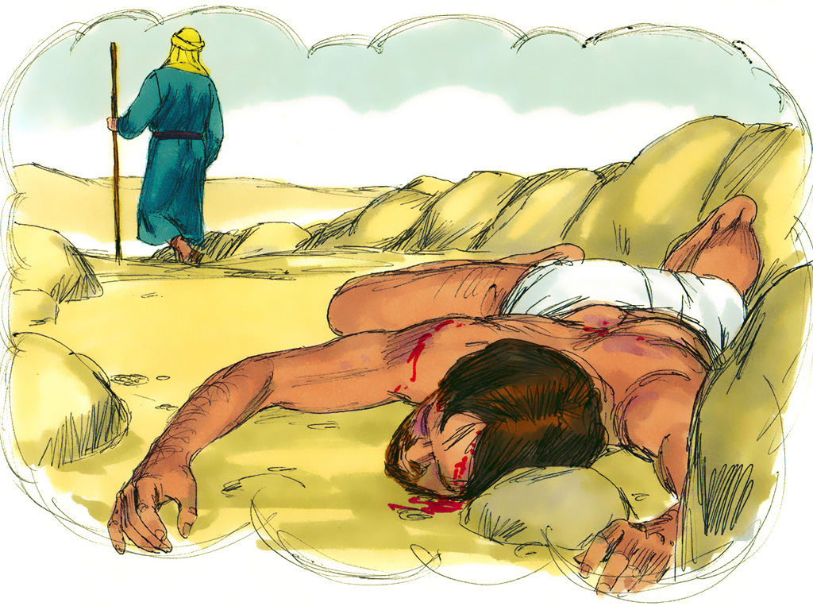
Notes:
Teacher’s Notes: ‘Another priest arrived next, went over and looked at the man, and then walked on by on the other side.

Slide 17
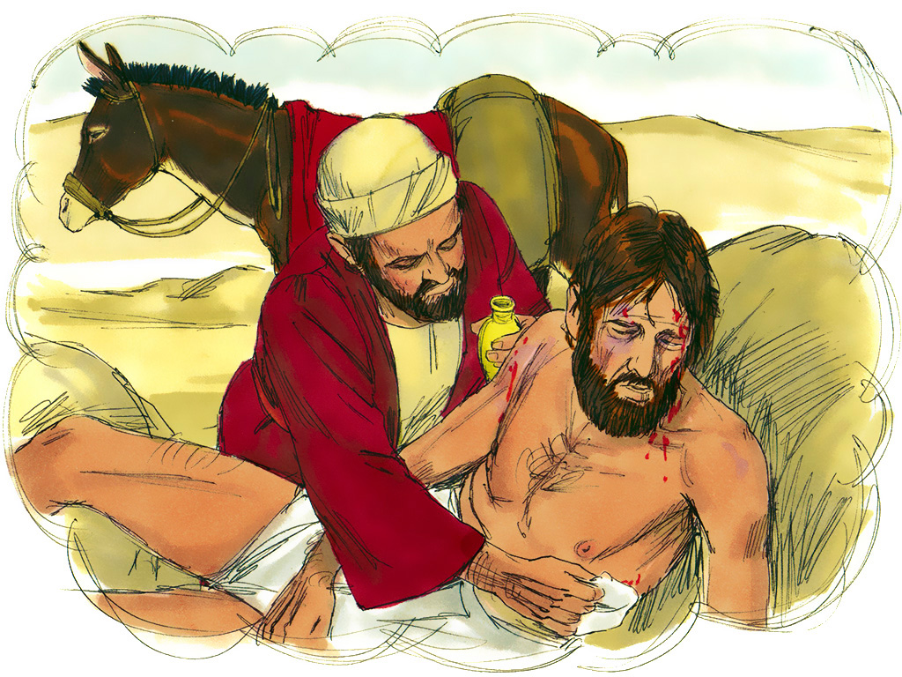
Notes:
Teacher’s Notes: ‘Then a Samaritan who was travelling that way came by. When he saw him, he stopped to help. He went over to him, poured oil and wine on his wounds and bandaged them.

Slide 18
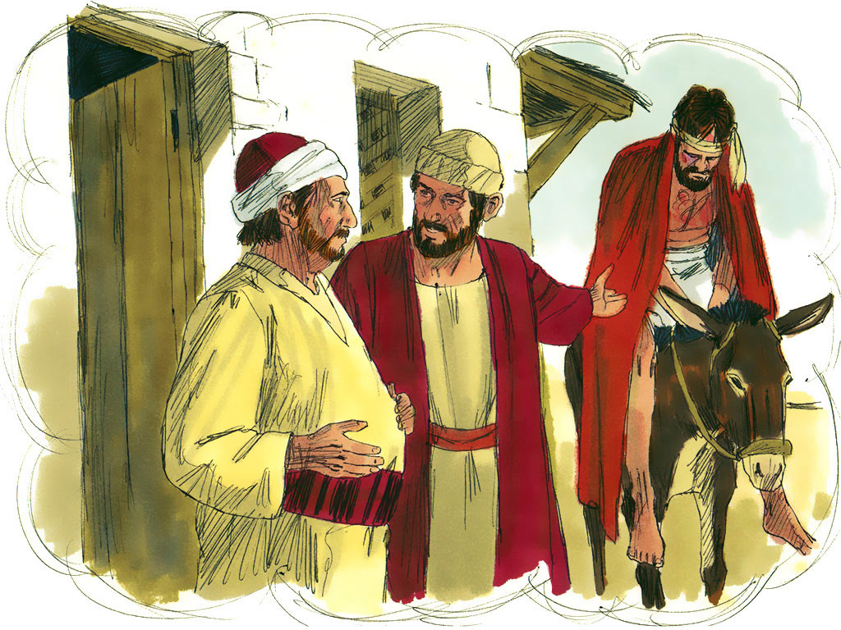
Notes:
Teacher’s Notes: Then he put the man on his own animal and took him to an inn.

Slide 19
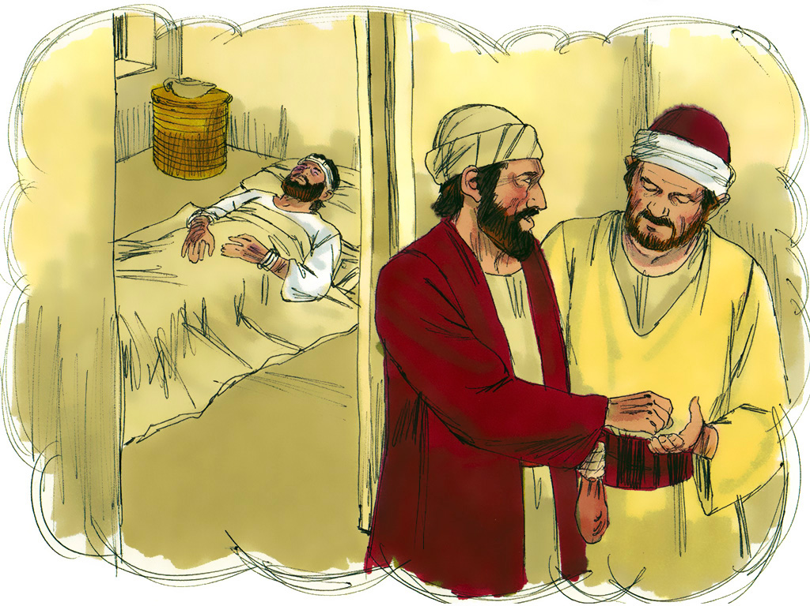
Notes:
Teacher’s Notes: ‘Then he took out two silver coins and gave them to the innkeeper. “Take care of him,” he told the innkeeper, “and when I come back this way, I will pay you whatever else you spend on him.”’

Slide 20
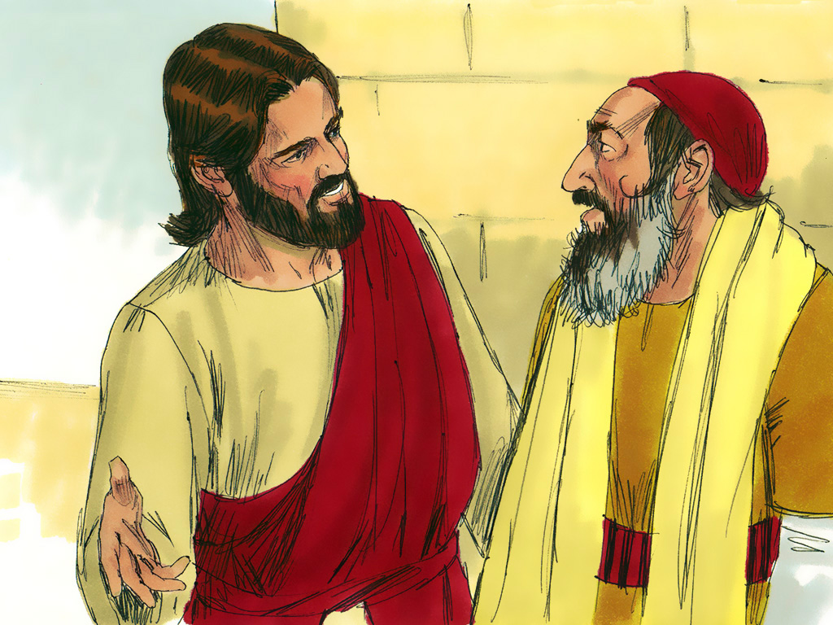
Notes:
Teacher’s Notes: After telling the story Jesus said to the man ‘Who do you think was his neighbour?’ The man answered, ‘The one who was kind to him and looked after him.’ Jesus replied, ‘Now I want you to go and do the same.’

Slide 21
Tell your partner about a time when you have helped someone? Tell them about a time you have been helped.
Notes:
Teacher’s Notes: Ask: Tell your partner about a time when you have helped someone? Tell them about a time you have been helped. How did you feel?

Slide 22

Going Forth
Think:
If everyone in this room showed love and helped
each other all the time – what
would it be like?
Notes:
Teacher’s Notes: Ask the class now to think carefully about this question for a few moments. ‘If everyone in this room helped each other all the time what would it be like?

Slide 23


Slide 24





