Slide 1
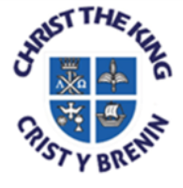
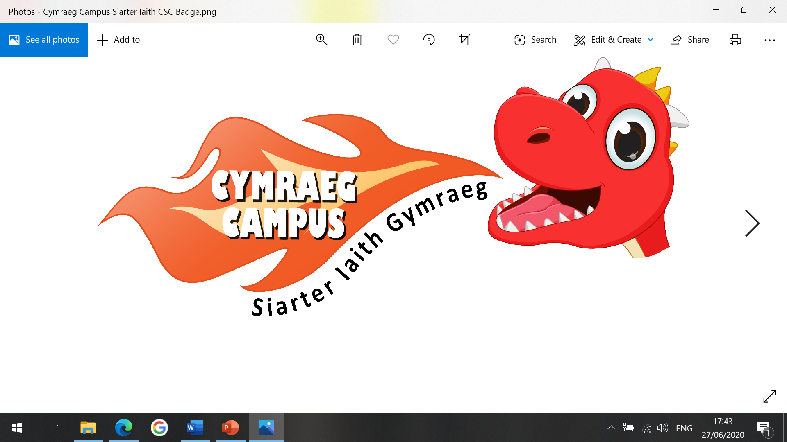
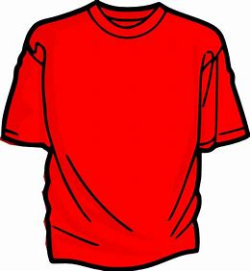

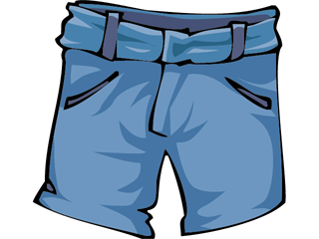

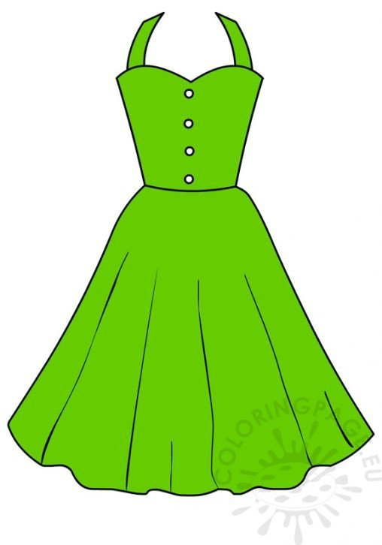
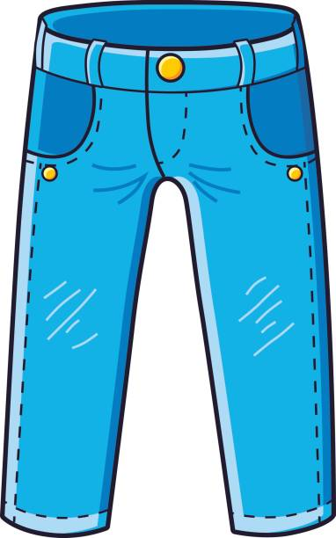
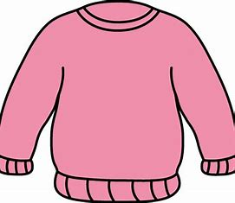
Ymadrodd o’r Wythnos
Beth wyt ti’n wisgo?
(Bear-th oyt-teen wis-goh?)
What are you wearing?
Dw i’n gwisgo crys-t coch a siorts glas achos mae hi’n heulog heddiw!
(Dween wis-goh crees-t cork ah shorts glass ackos my heen hey-log heth-oo!)
I’m wearing a red t-shirt and blue shorts because it’s sunny today!
Dw i’n gwisgo ffrog gwyrdd a treinyrs du i’r parti!
Dween gwis-goh frog gw-ur-th ah tray-nears dee ear party.
I’m wearing a green dress and black trainers to the party.
Dw i’n gwisgo siwmper pinc a jins glas i chwarae yn y parc.
Dwee gwis-goh shum-pear pink ah jins glass ee kwar-eye un-er park.
I’m wearing a pink jumper and blue jeans to play in the park.

