Slide 1

A parent’s guide
to
online learning platforms

Slide 2
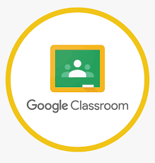

Pupils at Christ the King predominantly use two online learning platforms to support learning both in and out of school.
Nursery
Reception
Year 1
Year 2
Year 3
Year 4
Year 5
Year 6

Slide 3
App based in the classroom
App/desktop based at home
All pupils receive individual access codes for home learning

Slide 4
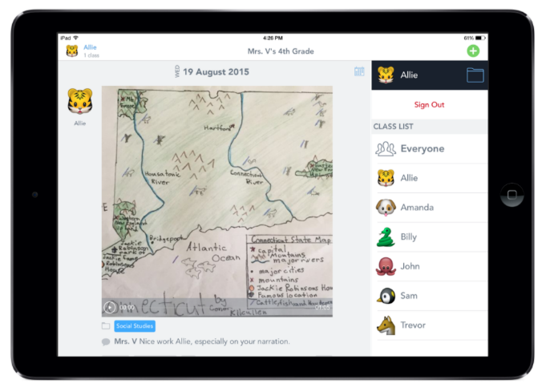
Seesaw is a simple way for teachers and students to record and share what's happening in the classroom.
Seesaw gives students a place to document their learning, be creative and learn how to use technology.
Each student gets their own journal and will add things to it, like photos, videos, drawings, or notes. Seesaw is used for both class and home learning.

Slide 5
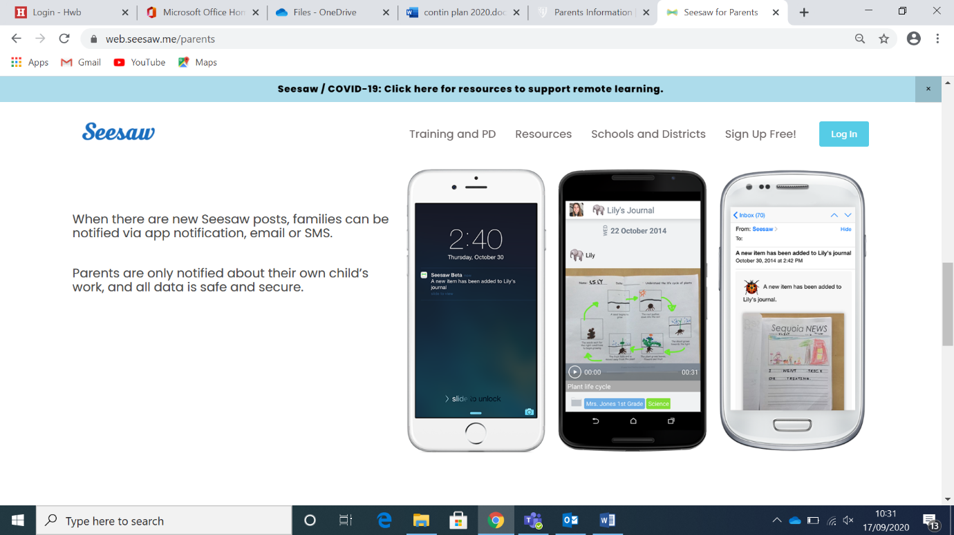
When there are new Seesaw posts, families can be notified via app notification.
Parents are only notified about their own child’s work, and all data is safe and secure.

Slide 6
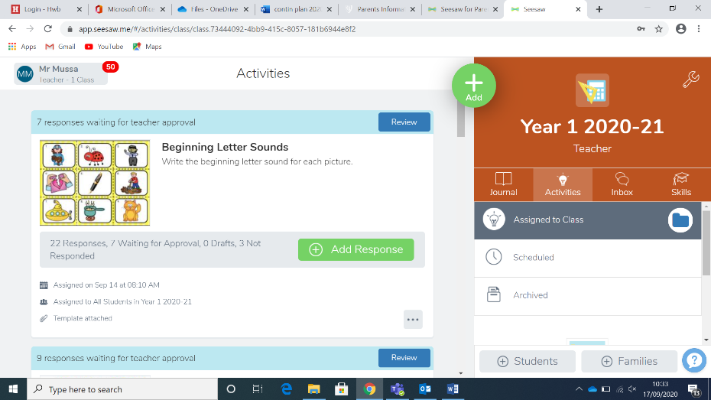
Learning log activities will be posted on Seesaw weekly and can be accessed by parents via the ‘activities’ tab.
Pupils can respond directly on seesaw or can complete paper-based tasks, but the expectation is that photographs of these tasks are taken and uploaded onto seesaw rather than handing in learning log books as was the tradition in the past.

Slide 7
Accessed through Hwb accounts
Blends learning in the classroom with home learning
All pupils receive individual Hwb log ins

Slide 8
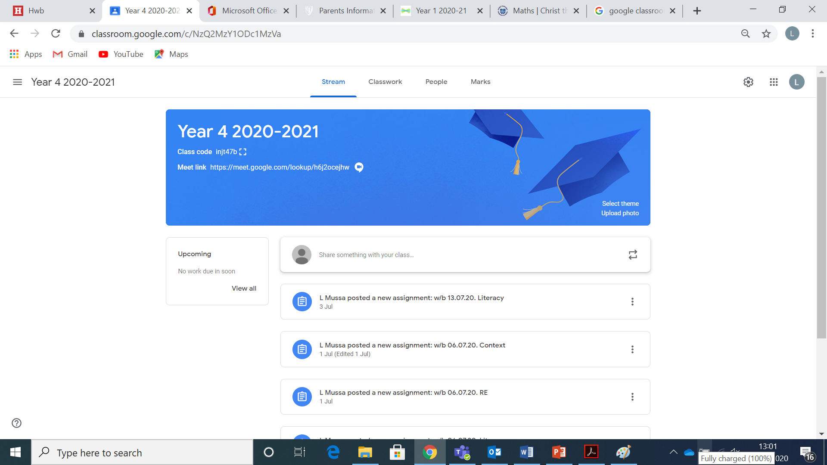
Google Classrooms is an online space for teachers and students to record and share learning resources and responses to learning.
Classrooms gives students a place to document their learning, work collaboratively and easily share learning with their teacher.
Each student gets their own storage space, access to Google tools and can be accessed both in school and at home.

Slide 9
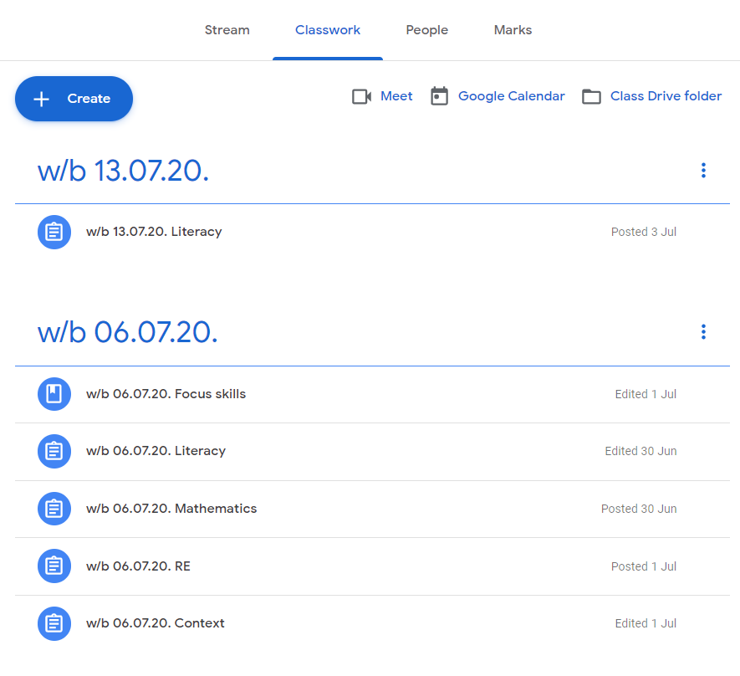
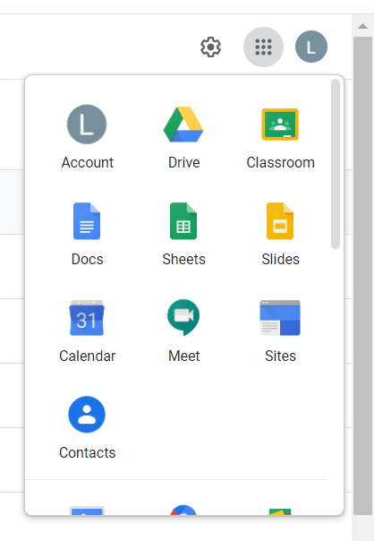
Pupils can respond directly on Google Classrooms using the available tools and ‘hand in’ to their teacher.
If work is undertaken on paper, the expectation is that photographs of these tasks are taken and uploaded rather than handing in learning log books as was the tradition in the past.
Learning log activities will be posted on Google Classrooms weekly and can be accessed at home in the same way pupils would access in the classroom.

